Slide 1

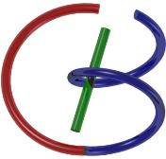
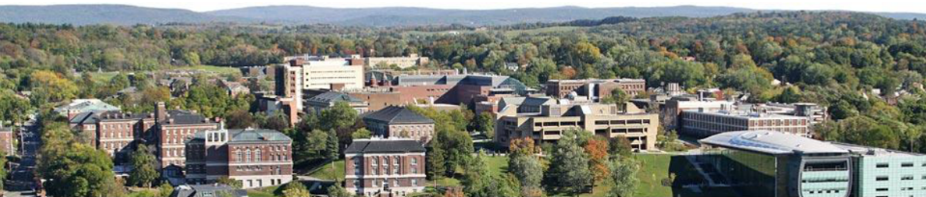
38655 BMED-2300-02
Lecture 24: Machine Learning
Ge Wang, PhD
Biomedical Imaging Center
CBIS/BME, RPI
wangg6@rpi.edu
April 24, 2018

Slide 2
BB Schedule for S18
Tue | Topic | Fri | Topic
1/16 | Introduction | 1/19 | MatLab I (Basics)
1/23 | System | 1/26 | Convolution
1/30 | Fourier Series | 2/02 | Fourier Transform
2/06 | Signal Processing | 2/09 | Discrete FT & FFT
2/13 | MatLab II (Homework) | 2/16 | Network
2/20 | No Class | 2/23 | Exam I
2/27 | Quality & Performance | 3/02 | X-ray & Radiography
3/06 | CT Reconstruction | 3/09 | CT Scanner
3/20 | MatLab III (CT) | 3/23 | Nuclear Physics
3/27 | PET & SPECT | 3/30 | MRI I
4/03 | Exam II | 4/06 | MRI II
4/10 | MRI III | 4/13 | Ultrasound I
4/17 | Ultrasound II | 4/20 | Optical Imaging
4/24 | Machine Learning | 4/27 | Exam III
Office Hour: Ge Tue & Fri 3-4 @ CBIS 3209 | wangg6@rpi.edu
Kathleen Mon 4-5 & Thurs 4-5 @ JEC 7045 | chens18@rpi.edu

Slide 3
Machine Learning
Background
Neural Network Review
Exemplary Applications
Deep Reconstruction
General Perspective
Recent Results
Future of Imaging
Rawdiomics
AVATAR

Slide 4
Simplest Version
Branches (Dendrite)
Body (Soma)
Interface (Synapsis)
Fiber (Axon)
Input
Output
Biological Neuron
Summation (Linear)
Weight
Transformation (Nonlinear)
Input
Output
Artificial Neuron

Slide 5
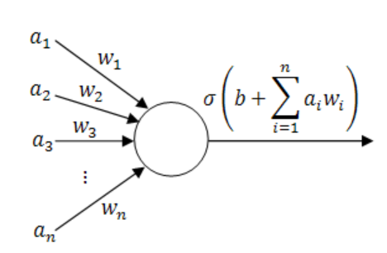
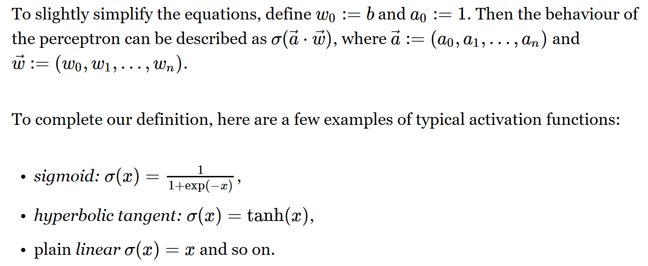
Perceptron

Slide 6
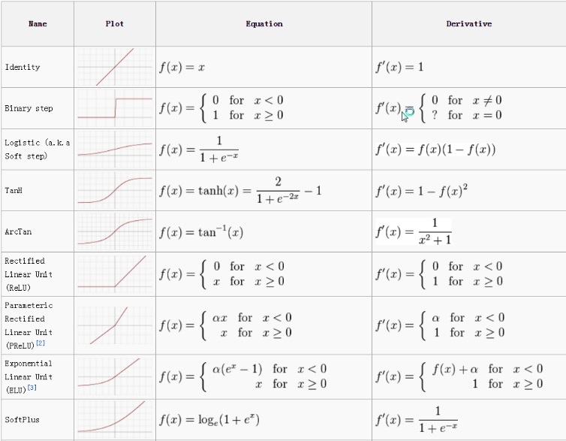
Activation Function

Slide 7
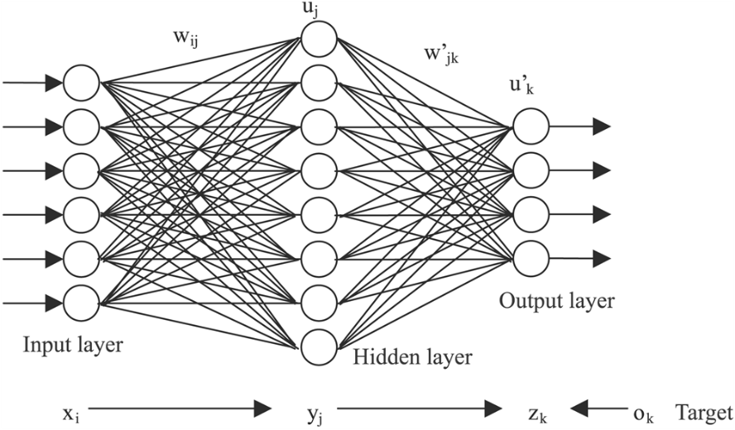
Artificial Neural Network
https://www.extremetech.com/extreme/215170-artificial-neural-networks-are-changing-the-world-what-are-they

Slide 8
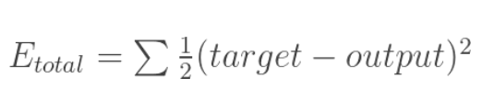
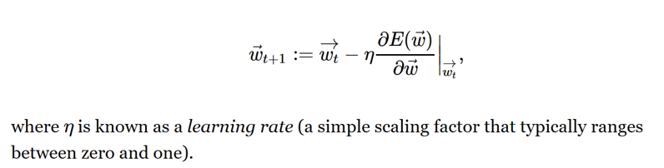
Optimization Problem
Objective Function
Parameter Refinement

Slide 9
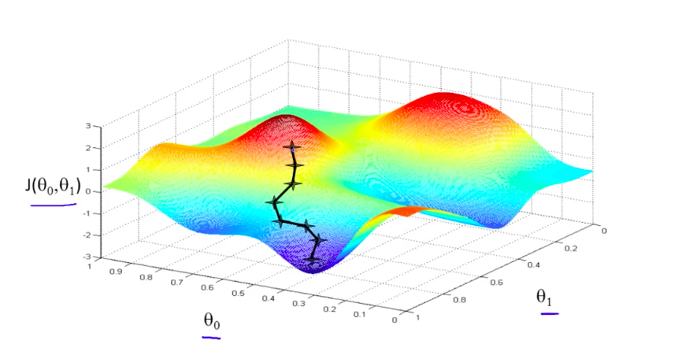
Gradient Descent Search

Slide 10
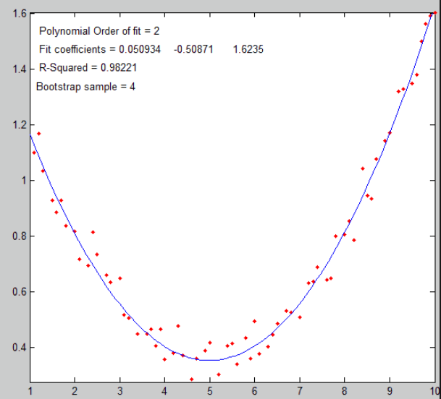
Simple Fitting

Slide 11
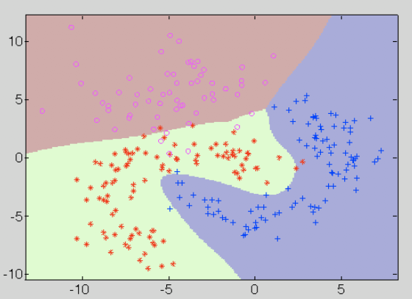
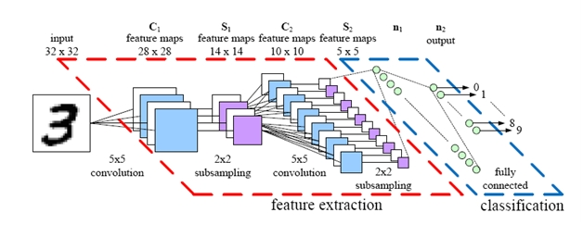
Sophisticated Fitting

Slide 12
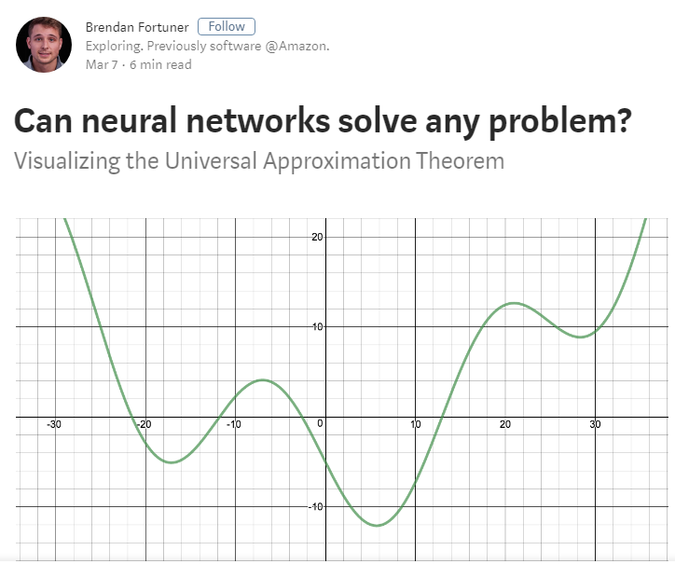
https://towardsdatascience.com/can-neural-networks-really-learn-any-function-65e106617fc6

Slide 13
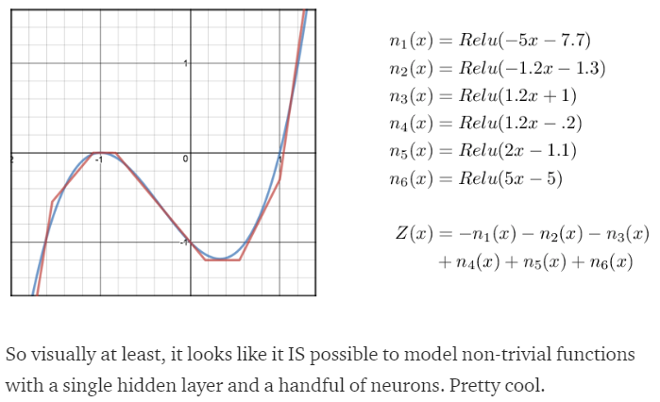
Fitting with ReLu

Slide 14
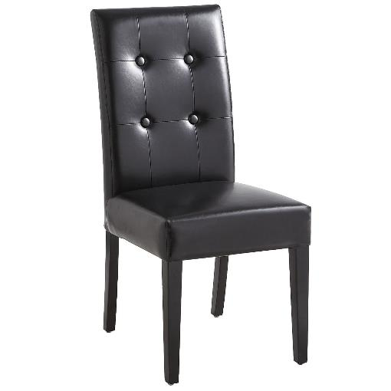
My Chair
Notes:
http://www.ecodesignz.com/Merchant2/graphics/00000001/ED_02SideChair_F.jpg No arms.

Slide 15
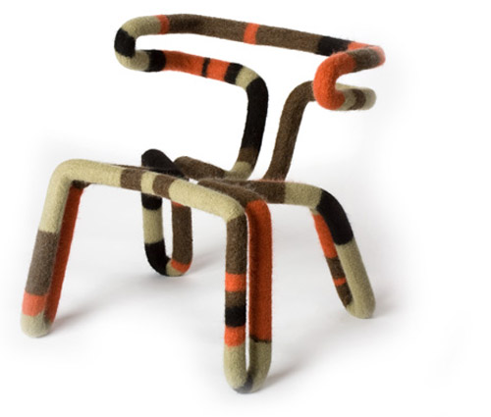
Is It Chair?
Notes:
http://homedecorators.com/images/items/large/l32369.jpg

Slide 16
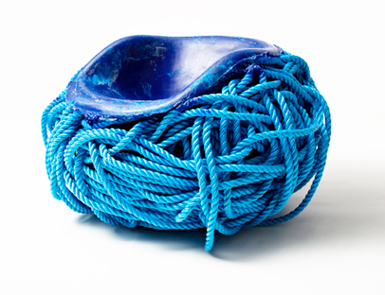
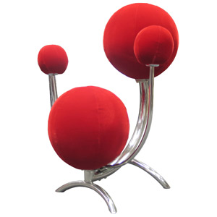
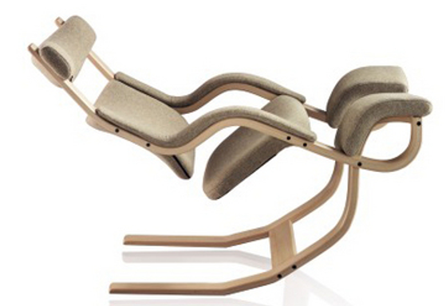
And These?
Notes:
http://images.google.com/imgres?imgurl=http://zedomax.com/blog/wp-content/uploads/2007/05/solar-system-chair.jpg&imgrefurl=http://zedomax.com/blog/tag/space/&h=300&w=300&sz=15&hl=en&start=105&tbnid=F9ZS2RMTee4s8M:&tbnh=116&tbnw=116&prev=/images%3Fq%3Dchair%26start%3D90%26gbv%3D2%26ndsp%3D18%26svnum%3D10%26hl%3Den%26sa%3DN

Slide 17
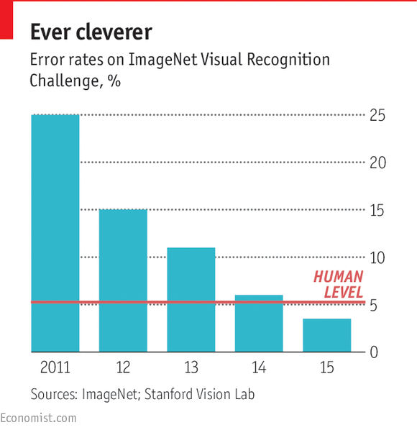
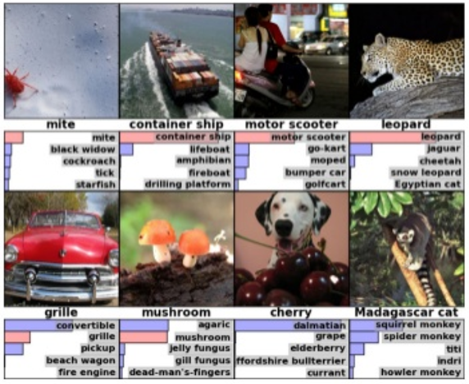
ImageNet Contest

Slide 18
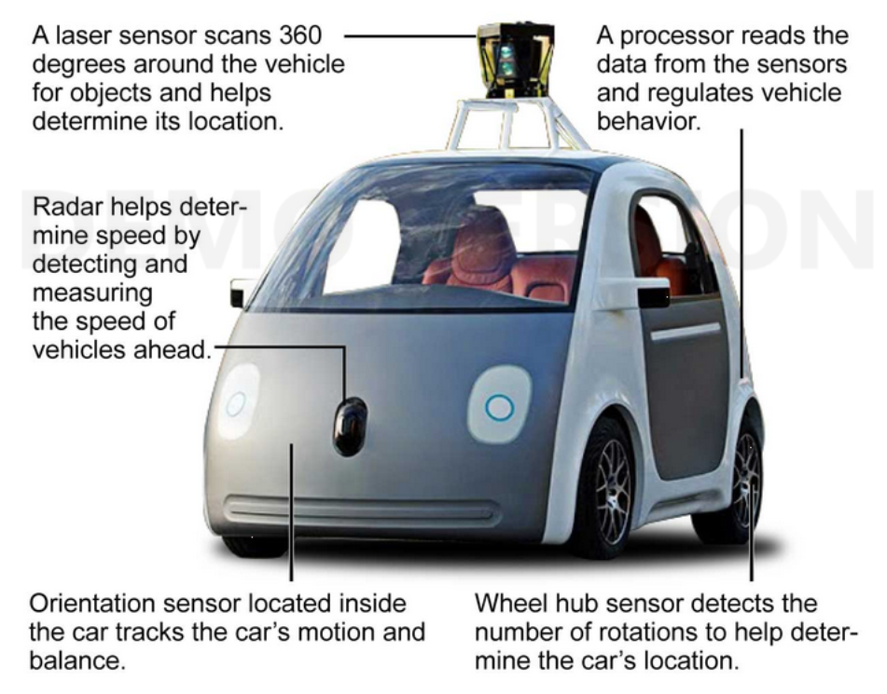
Google’s Self-driving Car

Slide 19
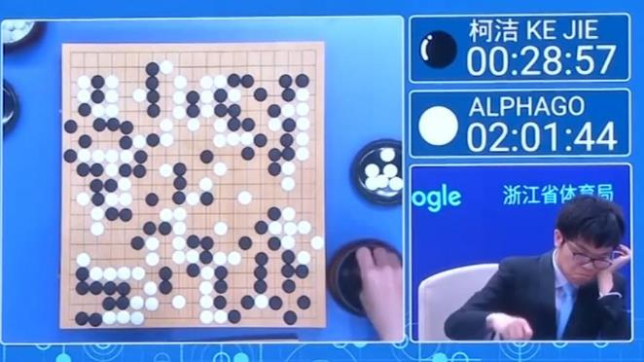
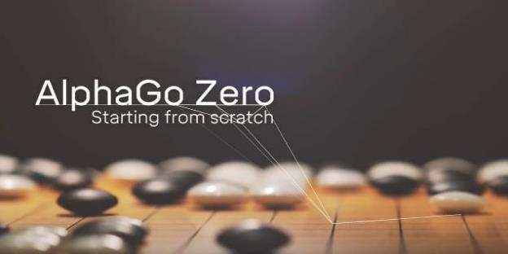
AlphaGo

Slide 20
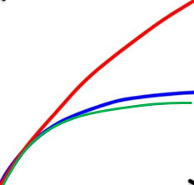
Why Deep Neural Network?
Deep Learning
Performance
Artificial Intelligence
Shallow Learning
Machine Learning
Other Methods
Big Data
Deep Learning
Data Size

Slide 21
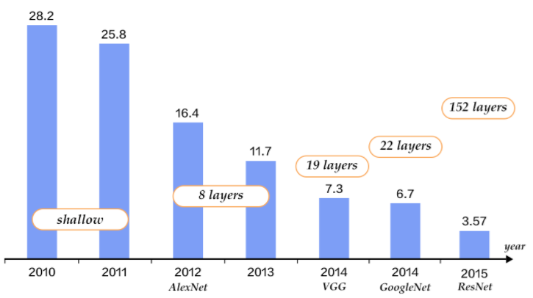
Exp Growth of Depth/Complexity
Top-5 Error Rate
If the correct answer is among the top 5 guesses, it is said in Top-5; otherwise, it is considered as an error
http://book.paddlepaddle.org/03.image_classification/

Slide 22
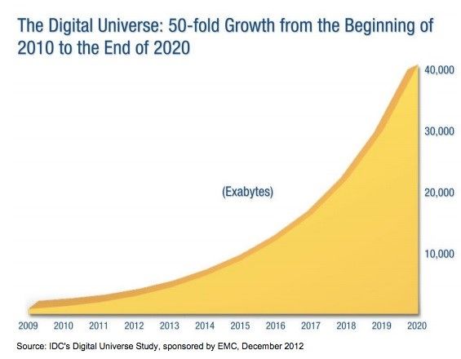
Exp Growth of Data Size

Slide 23
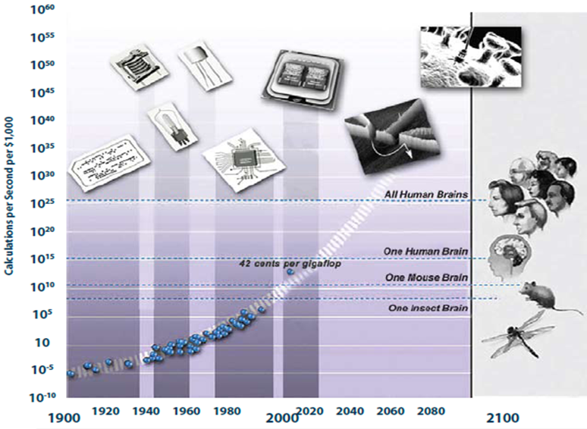
Exp Growth of Computing Power

Slide 24
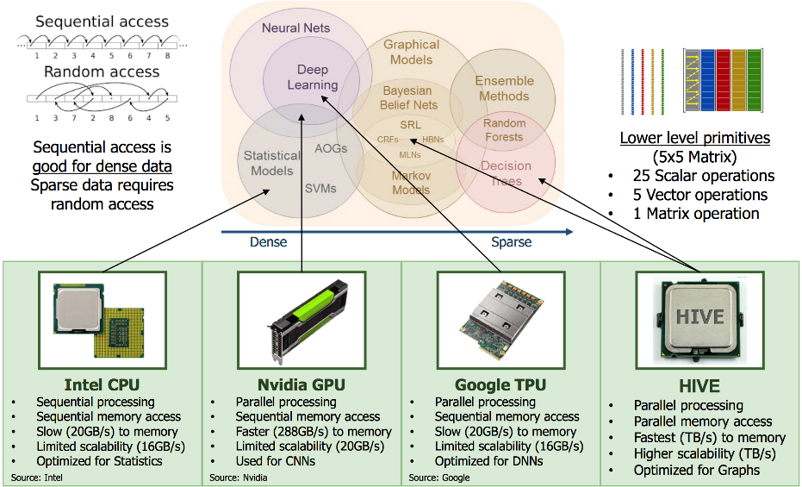
CPU, GPU, & TPU

Slide 25
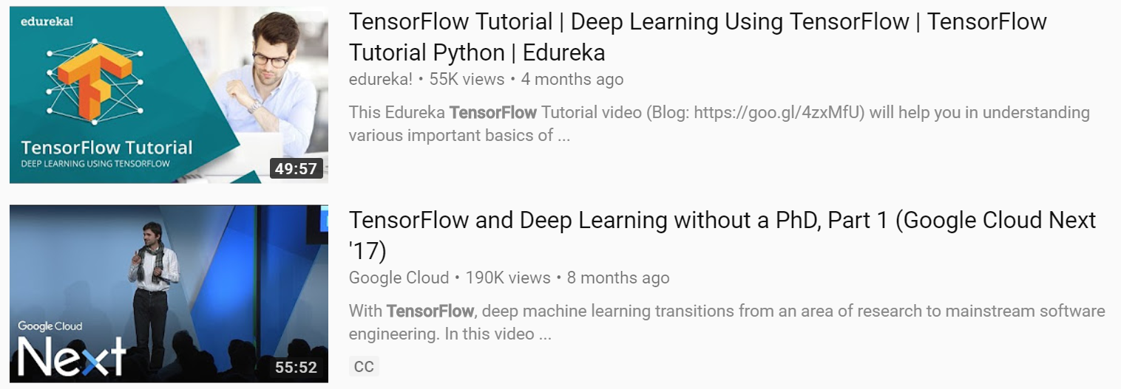
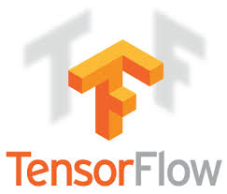

Python & TensorFlow

Slide 26
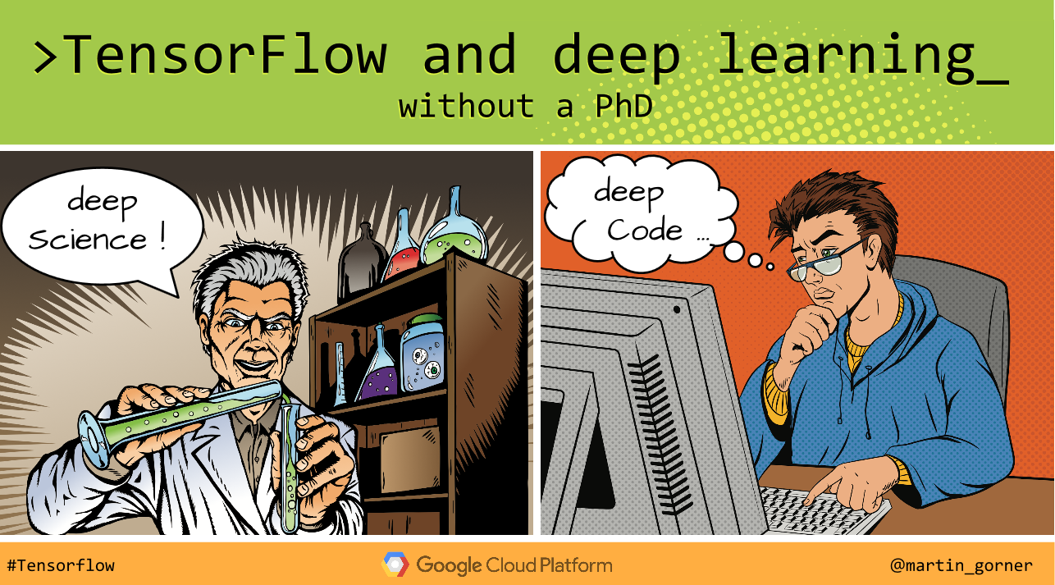
Hands-on Project
https://cloud.google.com/blog/big-data/2017/01/learn-tensorflow-and-deep-learning-without-a-phd

Slide 27
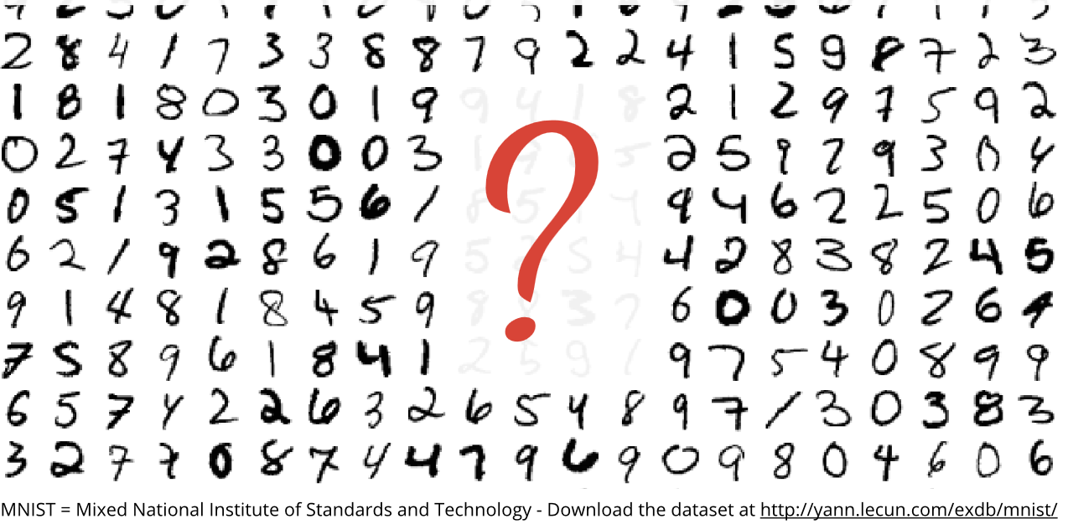
MNIST Dataset

Slide 28
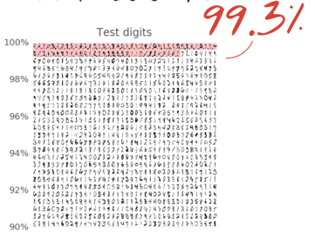
All Together: Super Performance!

Slide 29
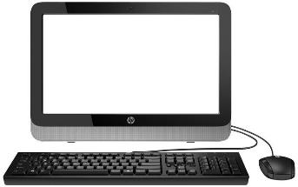
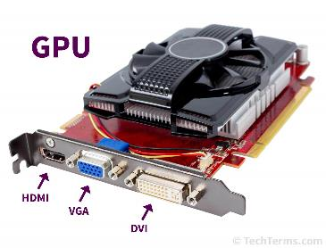
Summary 1: Coding vs Learning
Data
Output
Program
Data
Network/
Program
Output

Slide 30
Machine Learning
Background
Neural Network Review
Exemplary Applications
Deep Reconstruction
General Perspective
Recent Results
Future of Imaging
Rawdiomics
AVATAR

Slide 31
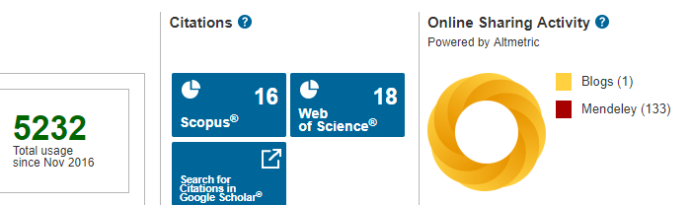
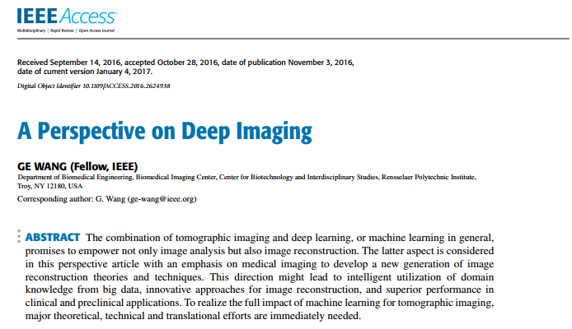
IEEE Perspective (2016)

Slide 32
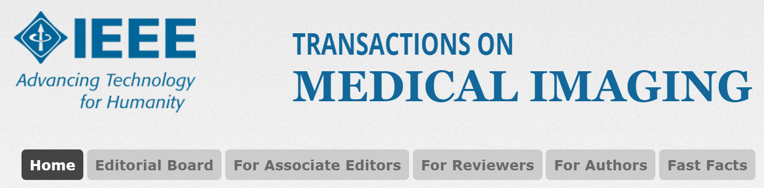
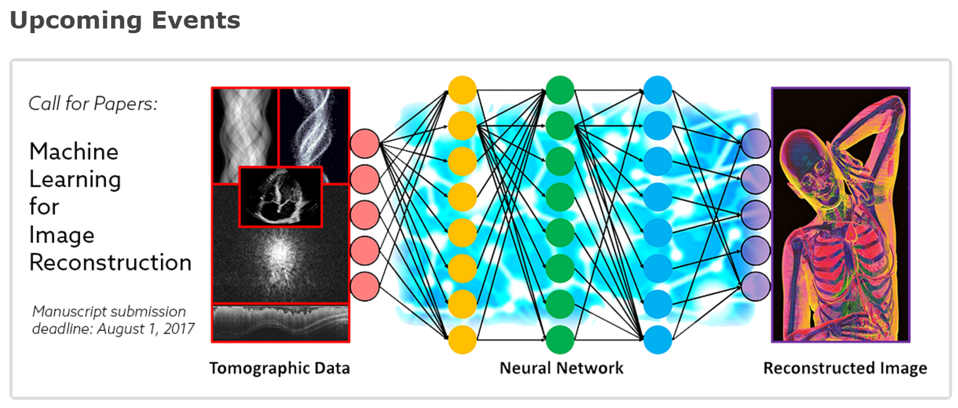

Slide 33
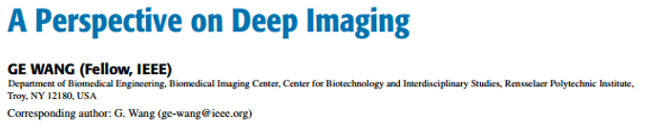
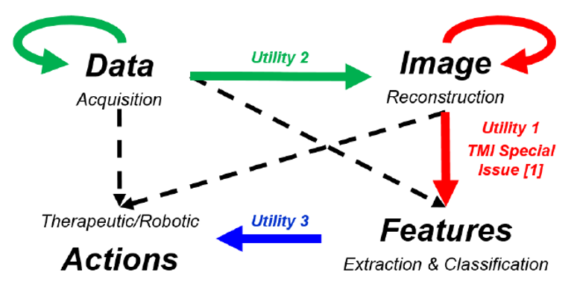
Smart Medicine

Slide 34
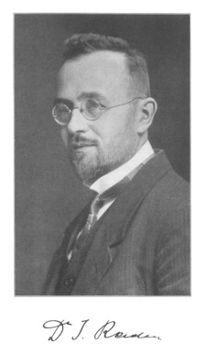
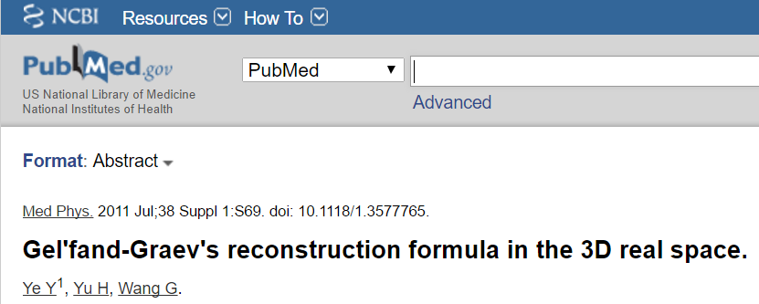
Analytic Approach
The Radon transform is based on integration over hyperplanes, instrumental in computed tomography, and “thoroughly” studied.

Slide 35
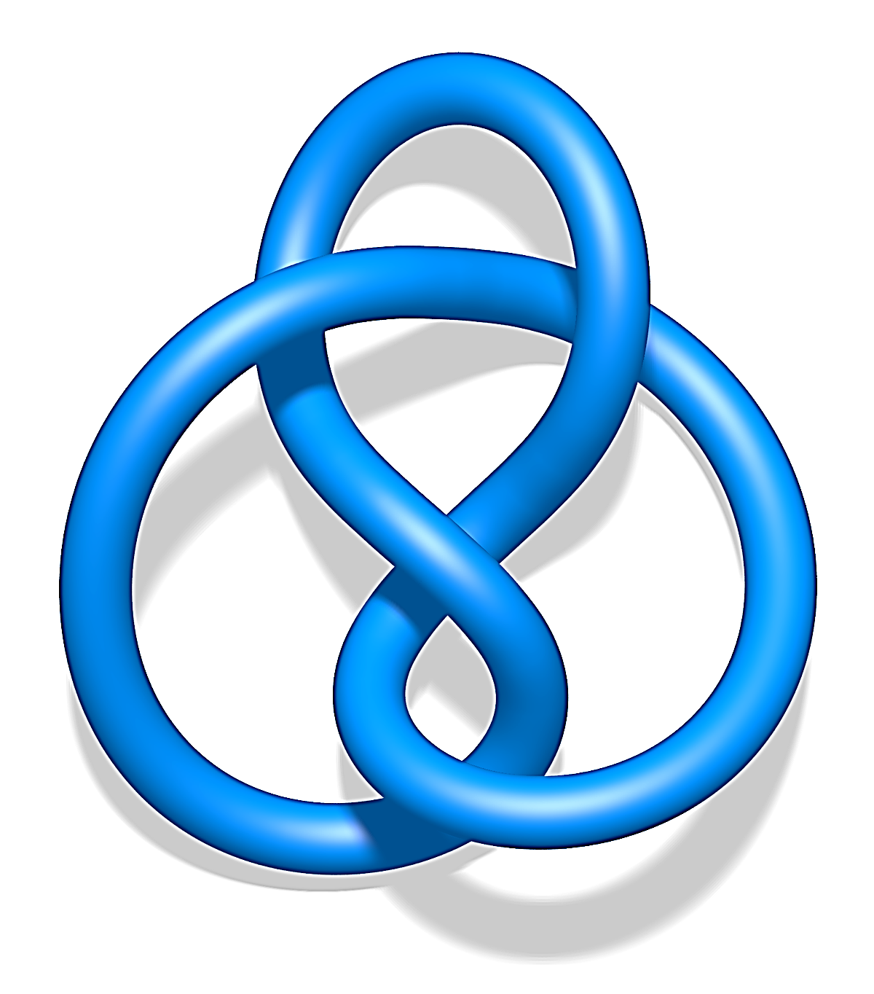
Iterative Approach
Least Square
Maximum Likelihood (ML)
Maximum A Posteriori (MAP)
Non-negativity
Maximum Entropy
Roughness Penalty
Minimum Total Variation (MTV)
Low Rank
Dictionary Learning
Low-dimensional Manifold
… …

Slide 36
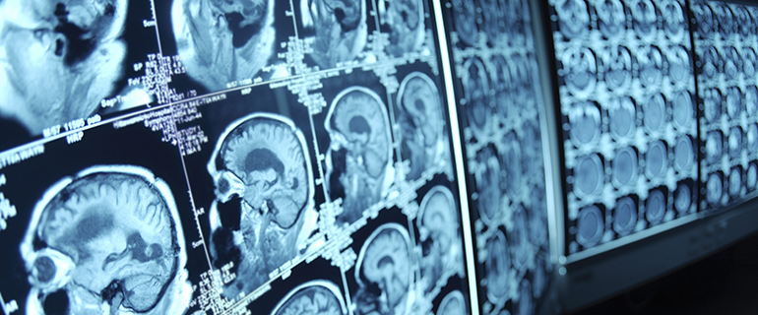
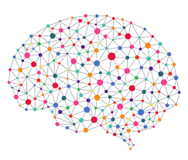
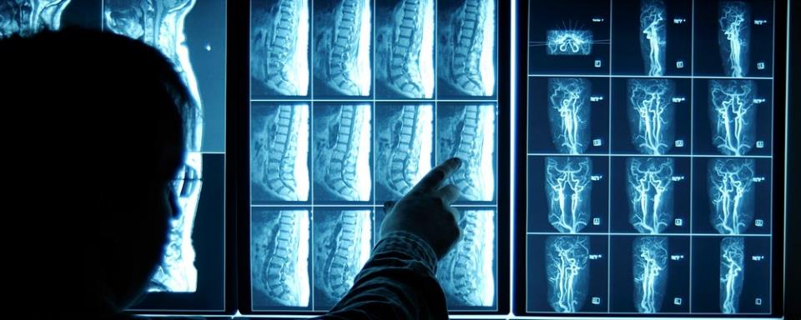
Learning Approach

Slide 37
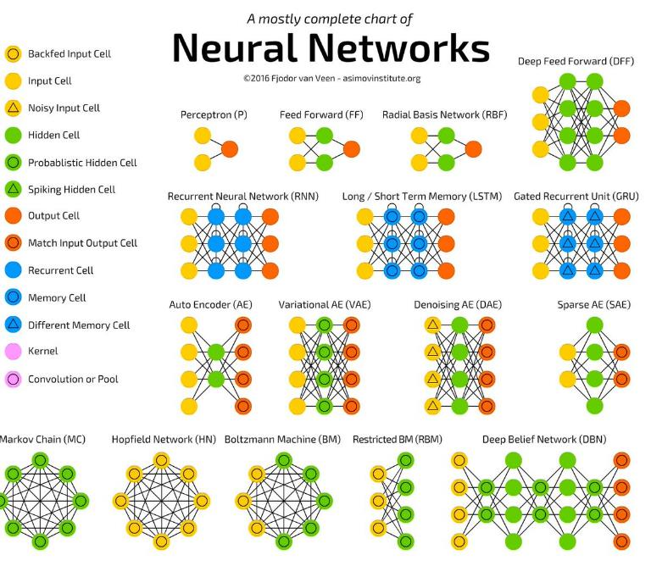
http://www.asimovinstitute.org/neural-network-zoo/

Slide 38
Not All Configurations Useful
Key Insights
Multi-scale Analysis (Wavelet Transform)
Convolutional Operation (Linear System)
Shortcut/Feedback (Control Theory)
Adversarial Mechanism (Game Theory)
Amplitude/Phase (Complex Analysis)
… …

Slide 39
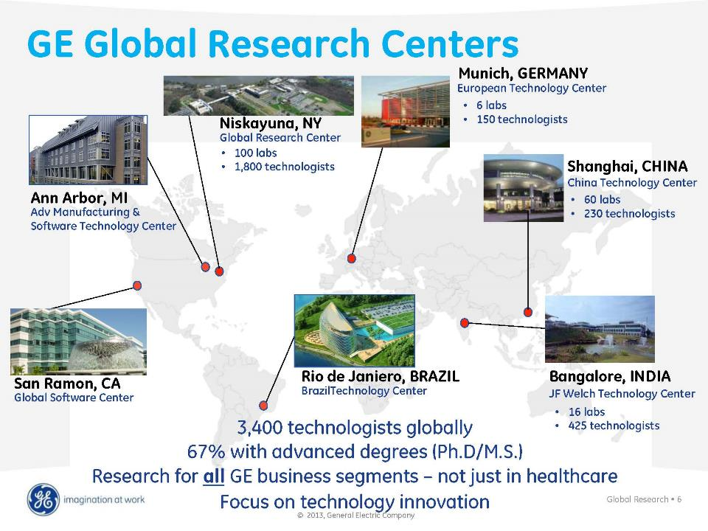

Slide 40



Strategic Long-term Partnership
On Deep Learning for
Tomographic Reconstruction
January 1, 2018 –

Slide 41

Post-Processing: Image to Image

Slide 42










Inner Working of RED-CNN
Encoder
Convolutional
De-conv
Decoder
ReLU

Slide 43



Low-dose CT vs WGAN-VGG
Notes:
FBP: photon starvation artifacts in lower part, nodule near the right kidney is limited

Slide 44




DenseNet
Extend to 3D convolutions (9 input slices)
FBP
RED-CNN
CPCE

Slide 45




Analytic Network: FBP
Convolutional
Sparsely Connected
Trainable Parameters
Back-projected
2D Image
Trainable Parameters
2D Sinogram from Vender
1D Filtered
Data

Slide 46












Iterative Network: “LEARN”
Under-sampled Data
Reconstruction
…
…
1st
2nd
t-th
(T-1)-th
T-th
Iteration-inspired Layer
Conv+ReLU
Conv

Slide 47

Quality Comparison (64 Views)
Reference FBP ASD-POCS Dual-DL
PWLS-TGV Gamma-Reg FBPConvNet LEARN

Slide 48

Features in ROI
Reference FBP ASD-POCS Dual-DL
PWLS-TGV Gamma-Reg FBPConvNet LEARN

Slide 49

Exterior Tomography

Slide 50



Data
Domain
Image
Domain

Slide 51




Smart Interpolator
True Image with
Metal Implant
True Data with Metal Trace
Reconstructed via
Deep Learning
Learned Data Eliminating Metal Trace

Slide 52
Superiority Principle
Take advantage of proven algorithms (NMAR)
Train a network on various artifacts
Improve beyond the state-of-the-art
CNN
Superior Image Quality
State-of-the-art MAR

Slide 53





Learning in the Image Domain
Input image: Already with correction from NMAR algorithm
Output image: Further MAR through CNN
CNN: Five convolution and five deconvolution layers
Supervised learning: Ground truth from simulation and/or experiments
3x3 Batch normalization (BN) in the first three layers, ReLU for activation
…
…

Slide 54

Work by Prof. Yu’s Group

Slide 55

UML Workflow

Slide 56


Clinical Results

Slide 57


Interior Tomography

Slide 58









Data-driven Interior Tomography
Truth
FBP
CNN
Horizontal Profiling
1
0.8
0.6
0.4
0.2
0
0
50
100
150
200
250
Truth
FBP
CNN
ROI
In Collaboration with Prof. Seung-Wook Lee’s Group at Pusan Univ., S. Korea, Patent Pending

Slide 59

Summary 2: Deep Recon

Slide 60


Slide 61
Machine Learning
Background
Neural Network Review
Exemplary Applications
Deep Reconstruction
General Perspective
Recent Results
Future of Imaging
Rawdiomics
AVATAR

Slide 62


Slide 63

Idea Published in Med. Phys.

Slide 64





Rawdiomics
Past
Normal Dataset
Analytic Recon
Crafted Features
Statistical Model
Present
Low-dose Dataset
Iterative Recon
CNN-based Features
Trained Network
Future
Low-dose Dataset
FBP Network
Improvement Network
Recon Image
ROI Segmentation
Deep Features
Final Diagnosis
Deep Recon
Rawdiomics
Deep Radiomics

Slide 65



Auto-driving Vehicle-based Affordable Tomography-Analytics Robots (AVATAR)
Ge Wang, PhD
Biomedical Imaging Center, BME, SoE, CBIS
Rensselaer Polytechnic Institute, Troy, New York, USA
April 18, 2018

Slide 66

Cost-effective Scanner

Slide 67

Slim Scanner
Already Designed
Collaborative Efforts by GE, RPI, & MGH

Slide 68


Auto-driving Cars

Slide 69


Boston Dynamics Robots

Slide 70

Future of Imaging
X-ray Imaging/CT
Ultrasound Imaging
Optical Imaging
Compact MRI
Other Types of Sensing/Testing
Intelligent Analyses

Slide 71
Convergence
Integration of High-techs
Tomography/Imaging/Sensing
Image Analytics/Informatics
Preventive, Individualized Healthcare
Control, Robot, Smart Materials
Auto-driving/flying
Machine Learning/Artificial Intelligence
Telecommunication/Internet

Slide 72
Testbeds
Typical Imaging Tasks Better Performed on Spot
Routine Imaging/Screening (Lung, Breast, etc.)
Natural Disaster Scenes (Patients Centered)
Battle Fields (Solders/Citizens Centered)
Infrastructural Inspection
(Bridge, Building, Power Station, etc.)
Space Exploration
… …

Slide 73
Summary 3: Internet of Service
Civilization Spanned by
Both Mobility & Connectivity
Bus Station → Private Cars → Uber Taxi
Direct Trading → Mall → Door-to-door
Cinema/Theater → Home Theater → iPhone TV
Gold → Bank → Apply Pay → Bitcoin
Radiology/Imaging Center → AVATAR
“Internet of Things” → “Internet of Service”

