Slide 1

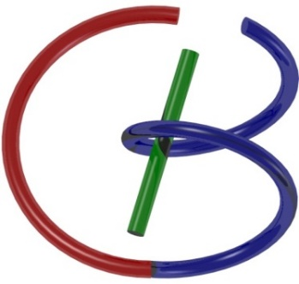
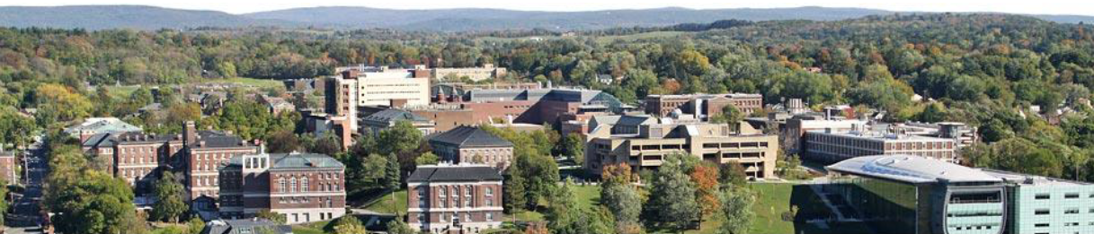
Last MRI Piece
Ge Wang
AI-based X-ray Imaging System (AXIS) Lab
Rensselaer Polytechnic Institute, Troy, New York, USA
Nov. 2, 2021

Slide 2
MI Schedule for F21
Tue | Topic | Fri | Topic
08/31 | Introduction | 09/03 | Neuron, Network & Backpropagation
09/07 | No Class | 09/10 | Hands-on 1: Python, Colab, & TensorF
09/14 | Architectures & Training | 09/19 | Hands-on 2: MNIST Classification
09/21 | Image Quality I | 09/24 | CT Physics
09/28 | CT Reconstruction | 10/01 | Deep CT Reconstruction
10/05 | Hands-on 3: CT Networks | 10/08 | More CT Contents
10/12 | MRI Physics | 10/15 | Spin-Echo
10/19 | K-Space Theorem | 10/22 | More MRI Contents
10/26 | Mid Exam | 10/29 | Deep MRI Reconstruction
11/02 | Hands-on 4: MRI Networks | 11/05 | Nuclear Physics
11/09 | Nuclear Imaging | 11/12 | US Imaging
11/16 | Optical Imaging | 11/19 | Multimodality Imaging
11/23 | Hands-on 5: Image Conversion | 11/26 | Thanksgiving
11/30 | Image Quality II | 12/03 | Stability, Interpretability, & Others
12/07 | Overview | 12/10 | Final Exam
Office Hour: Teaching Day 5-6pm: https://rensselaer.webex.com/meet/wangg6

Slide 3
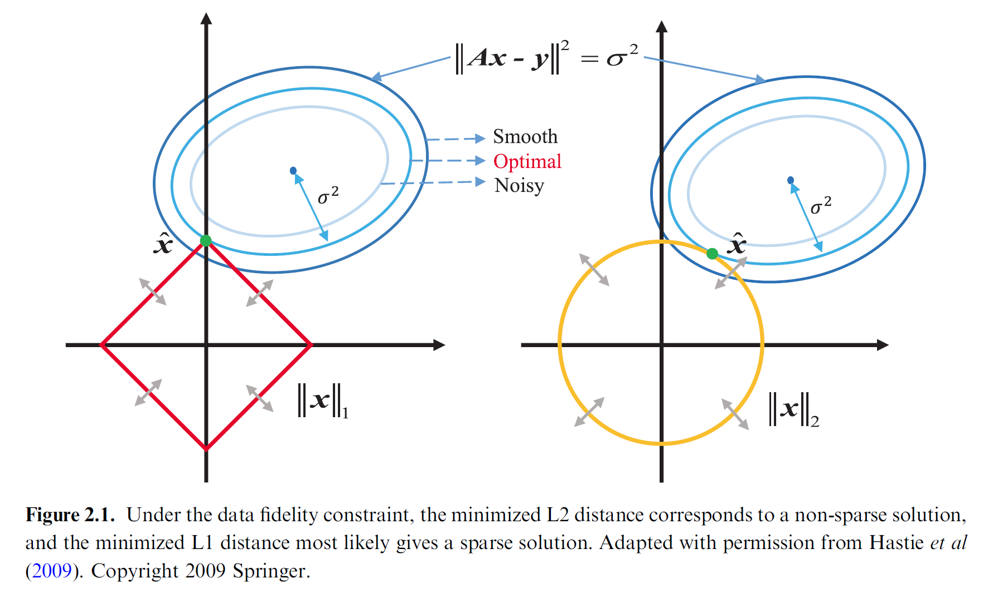
Regularized Sparse Reconstruction

Slide 5
Outline
CS-based MRI Reconstruction
Deep MRI Recon Networks
Fingerprint & SPIN
Network Techniques

Slide 6
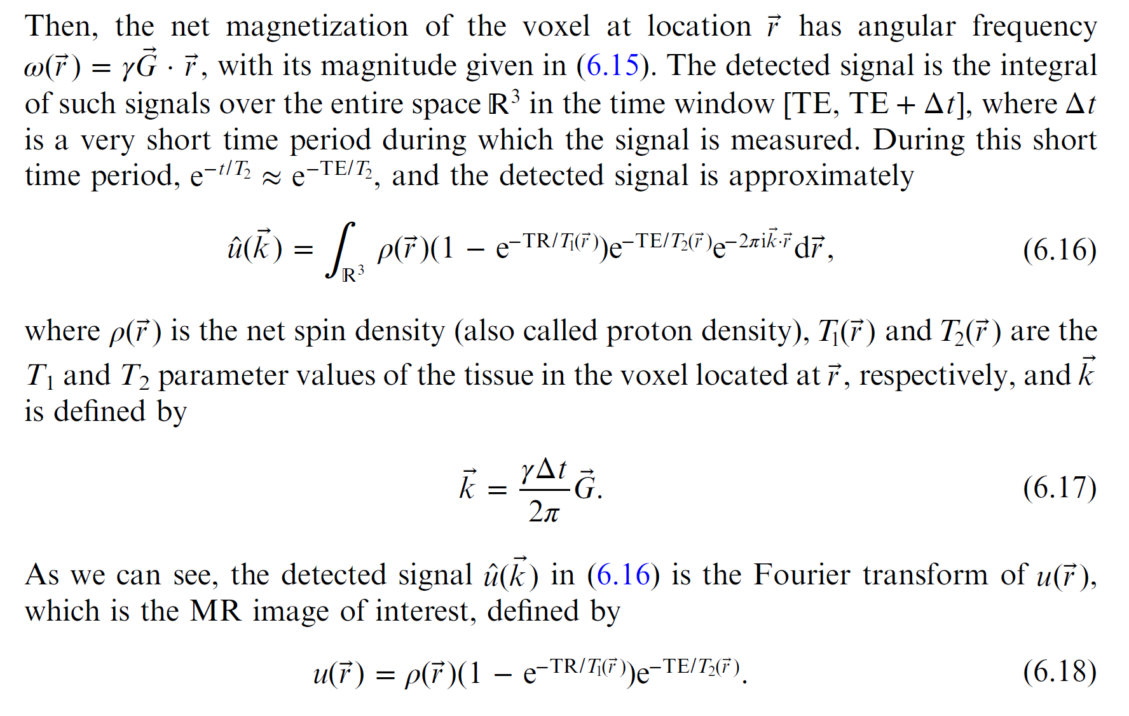
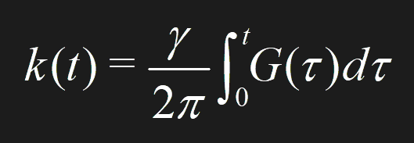

Data Collection in the k-Space

Slide 7
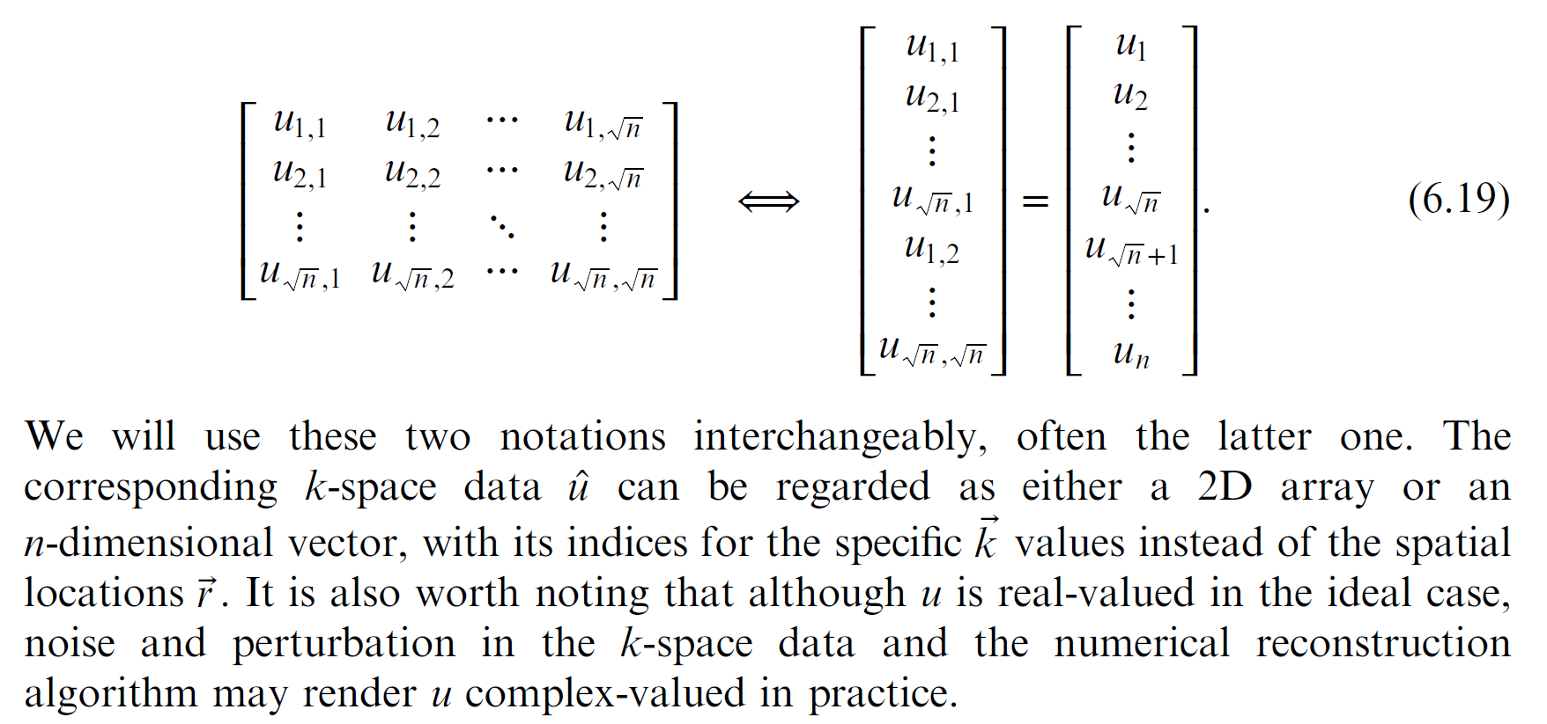
Data Matrix/Vector

Slide 8
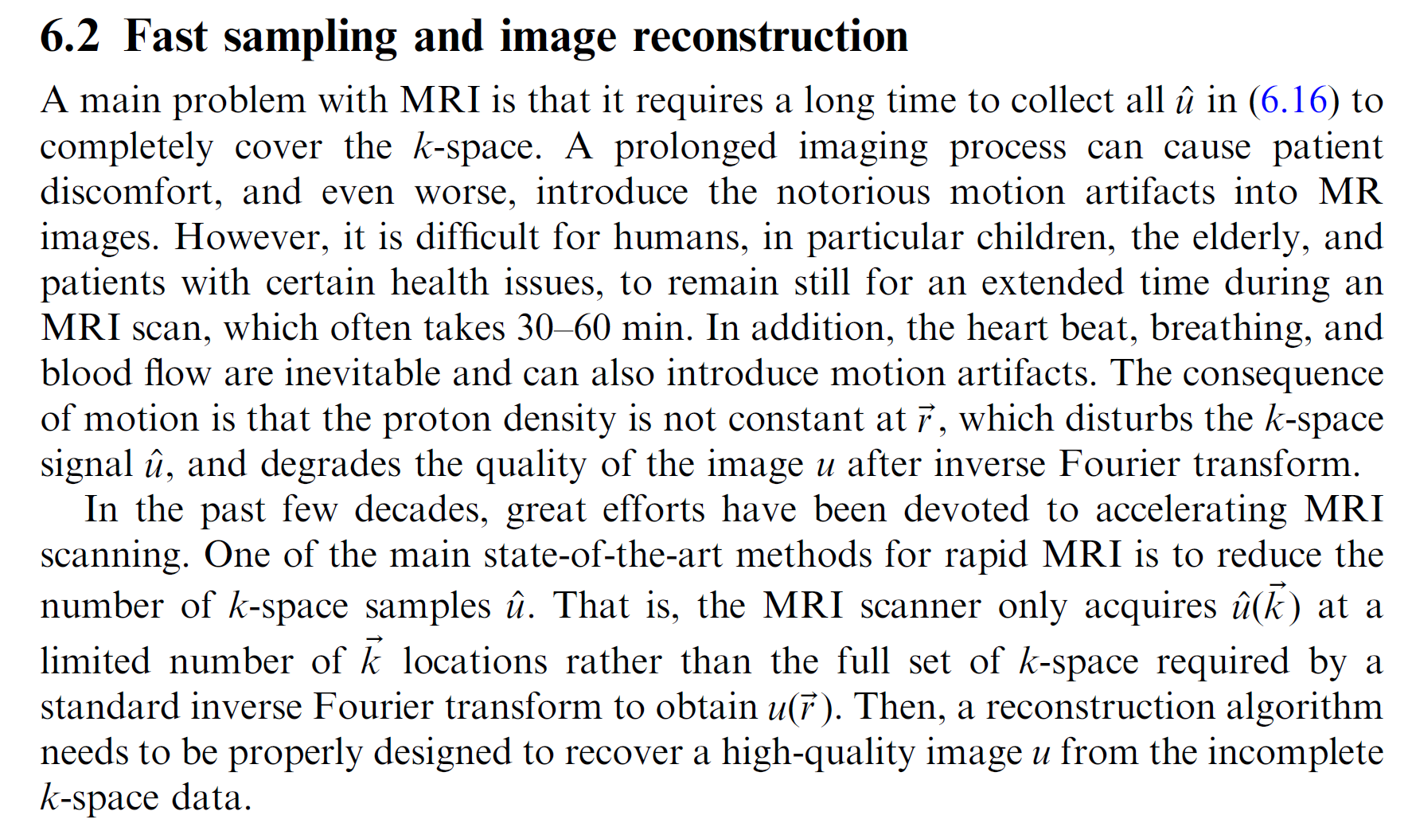
Fast MRI

Slide 9
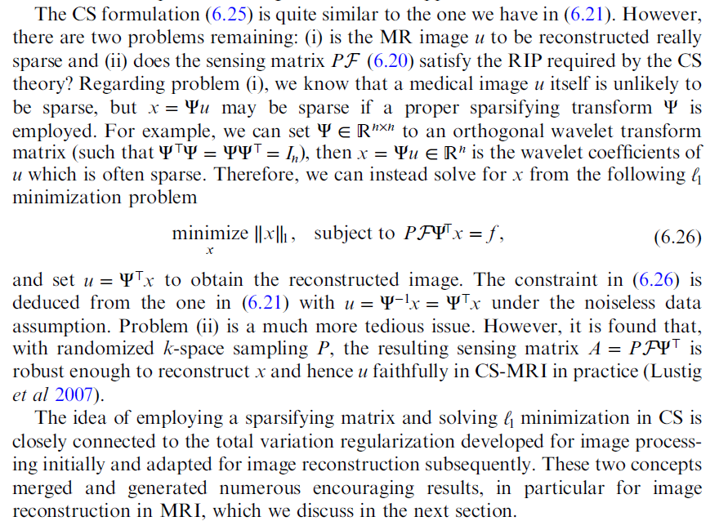
Sparsity in a Transform Domain

Slide 10
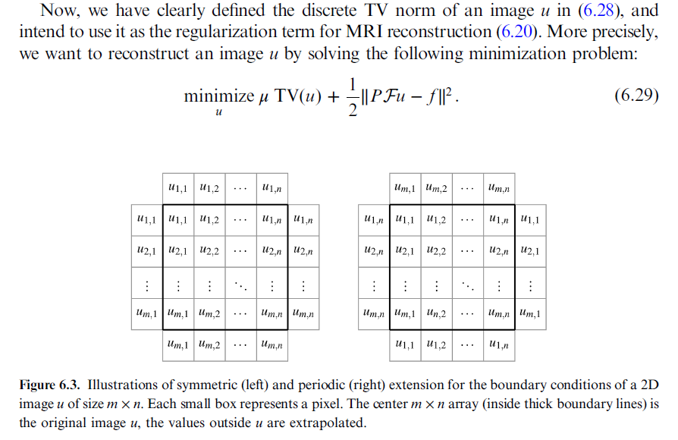
TV-based MRI Reconstruction

Slide 11
L0 Norm Replaced by L1 Norm
$$\vec{y}=Φ\vec{s}=ΦΨ\vec{x}=A\vec{x}$$
$$Ψ^{−1}\vec{s}=\vec{x}$$
Measurement
Sparsifying
$\vec{s}$= ${Min \atop \vec{s}}$|| $\vec{y}−Φ\vec{s}$||₂+${λ||Ψ}^{−1}\vec{s}||1$
Objective Function consists of two terms:
The first is data fidelity
The second is prior information

Slide 12
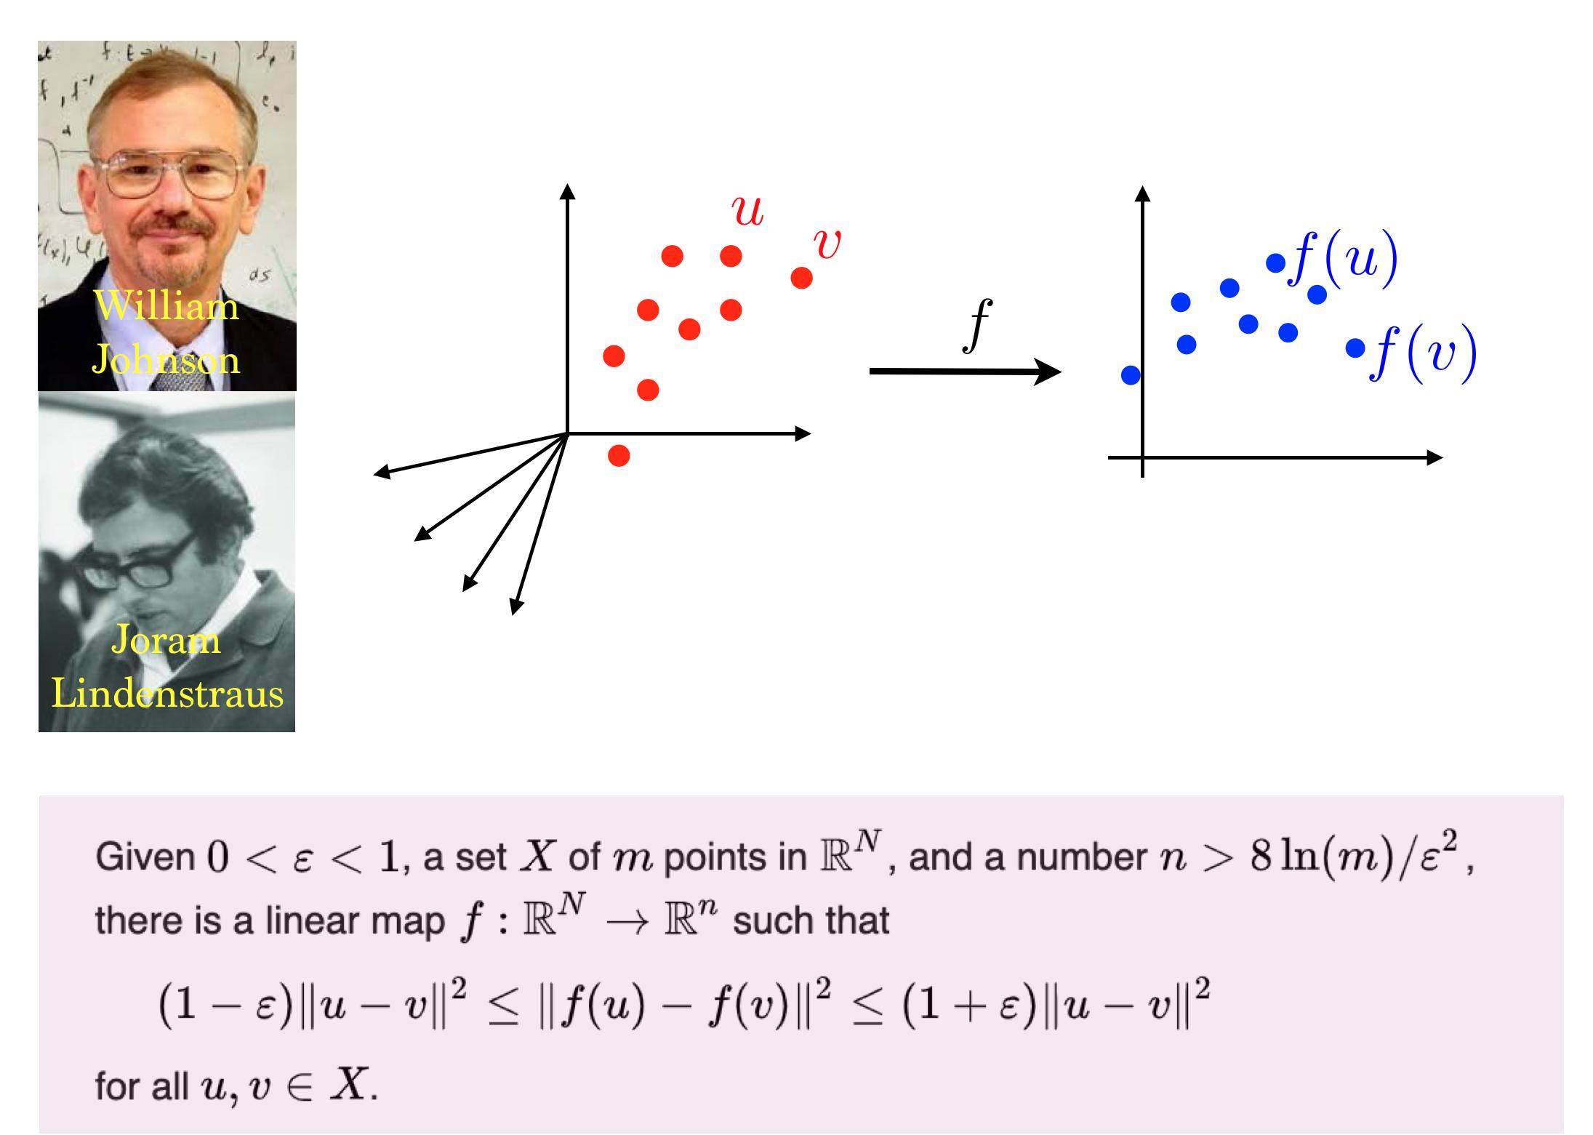
Johnson-Lindenstrauss Lemma
https://twitter.com/gabrielpeyre/status/1178534938850795520/photo/1

Slide 13
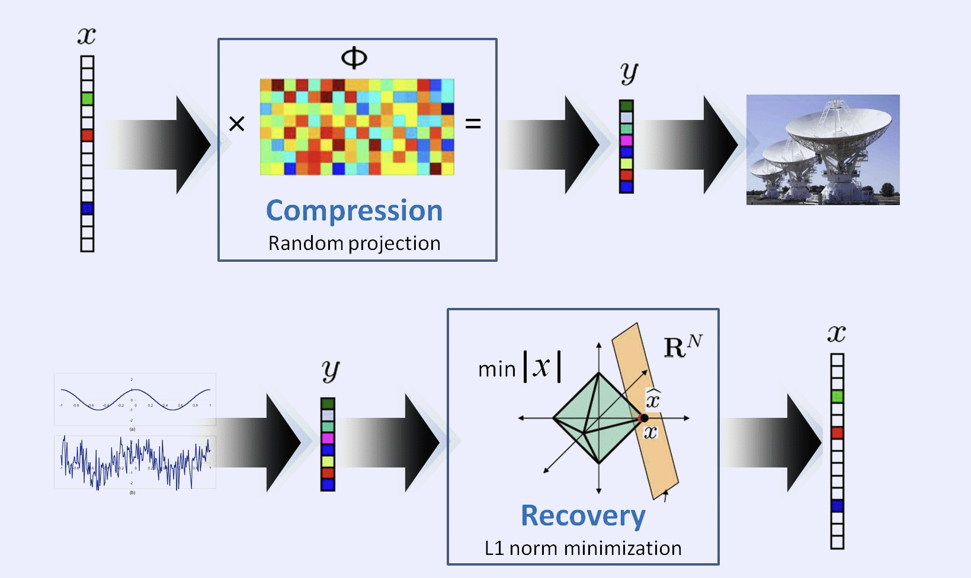
Random Matrix
https://www.ti.rwth-aachen.de/research/applications/cs.php

Slide 14
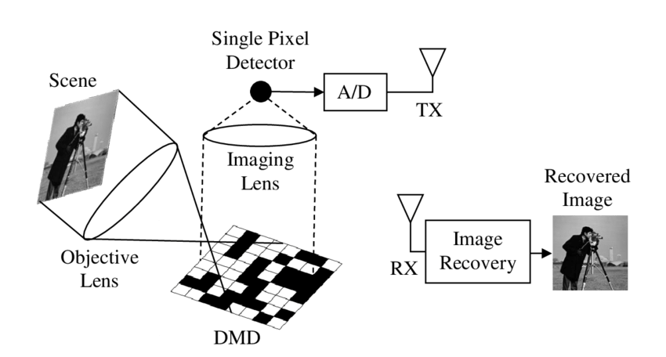
Single Pixel Camera
https://www.researchgate.net/figure/Single-pixel-camera-diagram_fig3_322963461

Slide 15
Outline
CS-based MRI Reconstruction
Deep MRI Recon Networks
Fingerprint & SPIN
Network Techniques

Slide 16
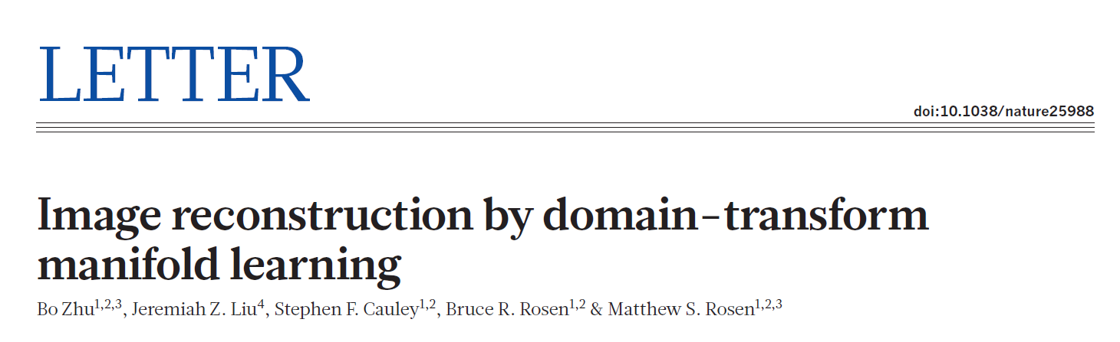
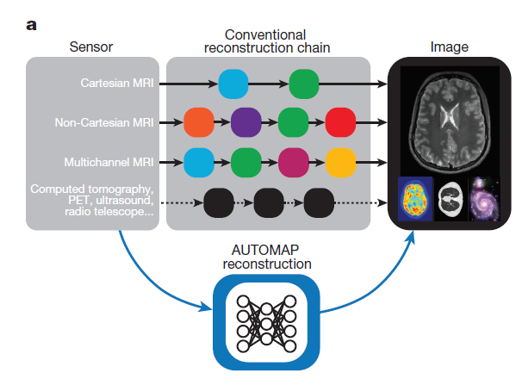
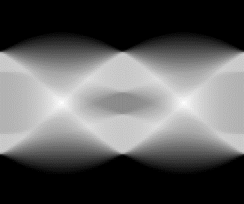
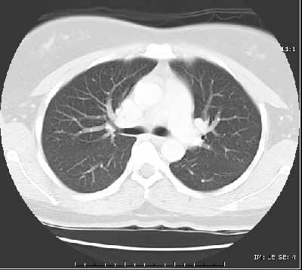
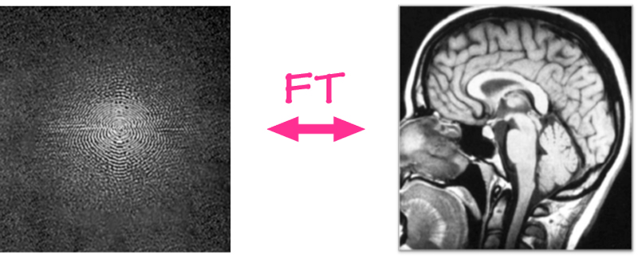
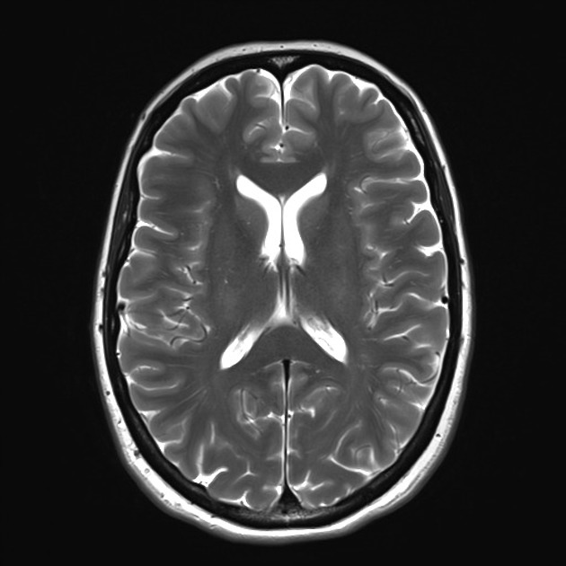
AUTOMAP
Conventional Reconstruction
  Via several discrete transforms
    Fourier
    Hilbert
    Radon
Automap Reconstruction
  Direct mapping from raw data to image
Inv. Radon
CT recon
Inv. Fourier
MRI recon

Slide 17
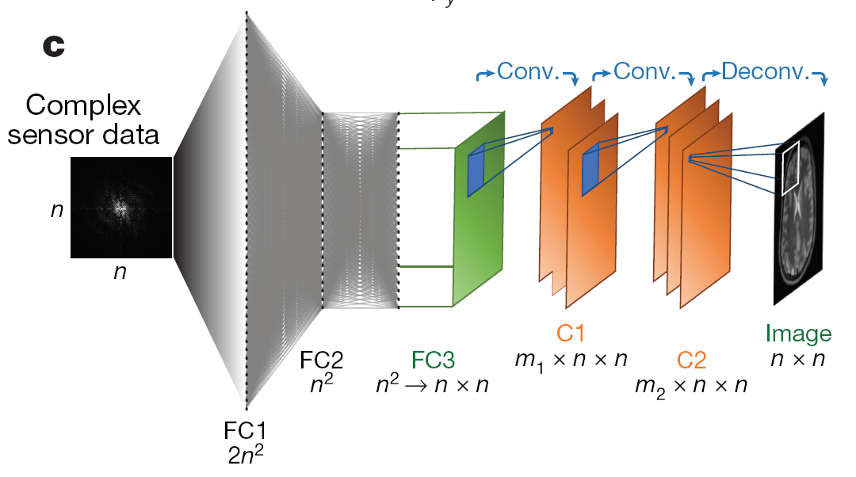
AUTOMAP
Direct mapping between complex-valued signal data and real-valued images
Two fully-connected layers
Three convolutional layers
https://doi.org/10.1038/nature25988

Slide 18
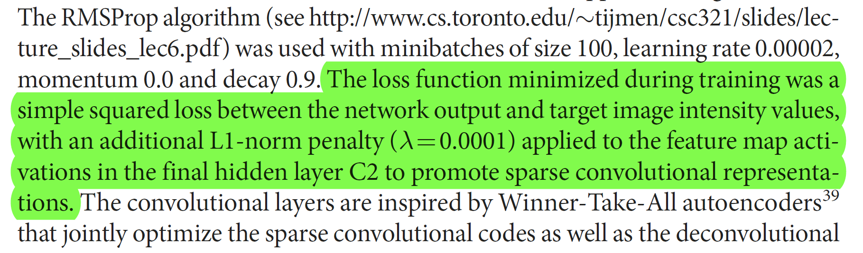
Loss Functions Used in Automap

Slide 19
MRI Data Preparation
Image
K-space
Fourier
transform
64
64
Label
Data

Slide 20
AUTOMAP
Inverse
Fourier
Transform
K-space
Image
In AUTOMAP, the inverse Fourier transform is learned by a neural network

Slide 21
Outline
CS-based MRI Reconstruction
Deep MRI Recon Networks
Fingerprint & SPIN
Network Techniques

Slide 22
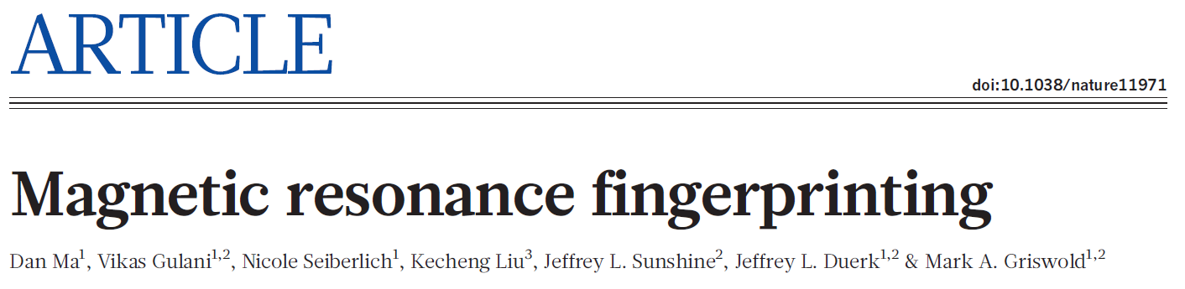
MR Fingerprinting
Simultaneously quantification of multiple tissue parameters
Fast scan with good high sensitivity

Slide 23
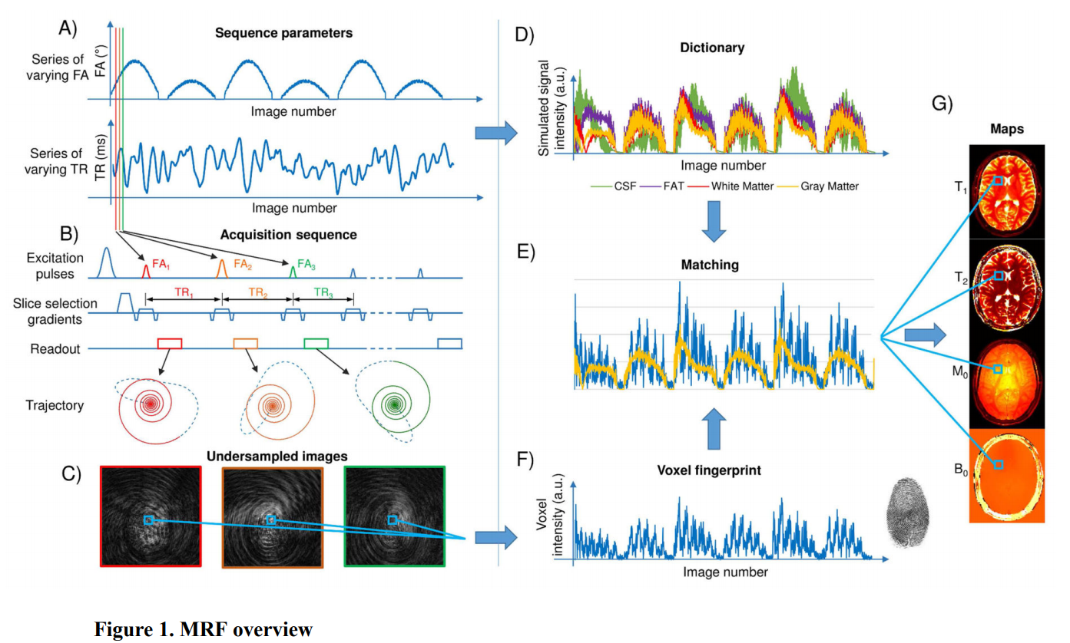
MR Fingerprinting
https://doi.org/10.1016/j.cobme.2017.11.001

Slide 24
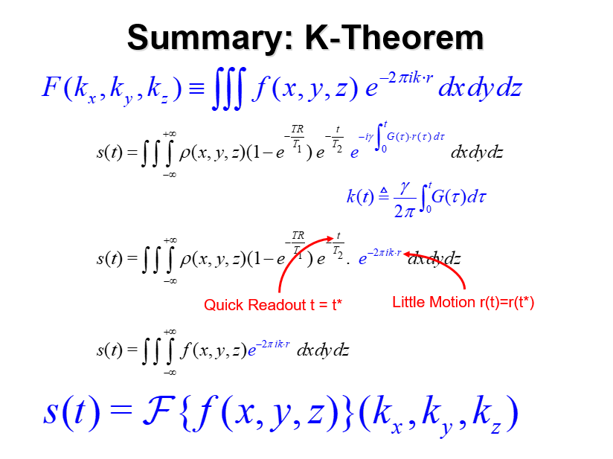
Not Optimized Yet
Kind of Random Signature
Pulse Sequence Has Not Been Optimized Yet
Dictionary Has Not Been Optimized Yet
Fourier Framework Is Not Perfect Either

Slide 25
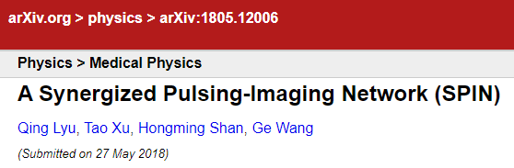
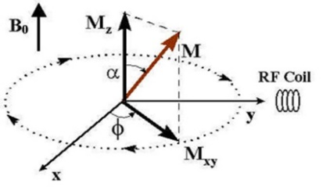
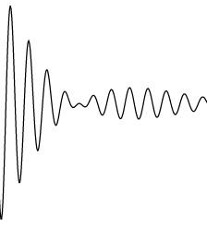
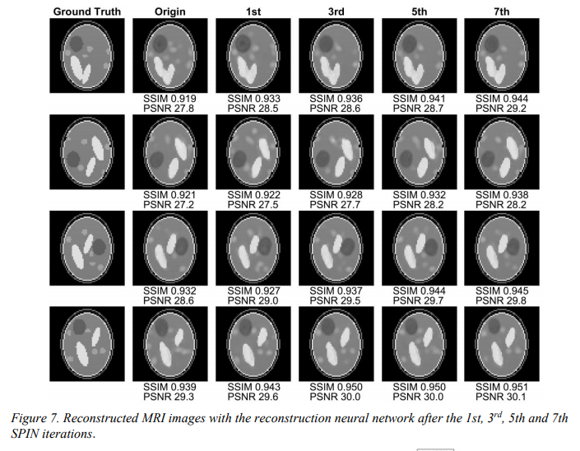


Synergized Pulsing-Imaging Network
RF
Pulse
Sequence
G_{x}
Dataset
G_{y}
Data Generation
Data Preprocessing
Truth
Pulse Sequence
Optimization
Recon
Network
ρ
T₁
Loss Function
T₂
Network Parameter
Optimization

Slide 26
Outline
CS-based MRI Reconstruction
Deep MRI Recon Networks
Fingerprint & SPIN
Network Techniques

Slide 27
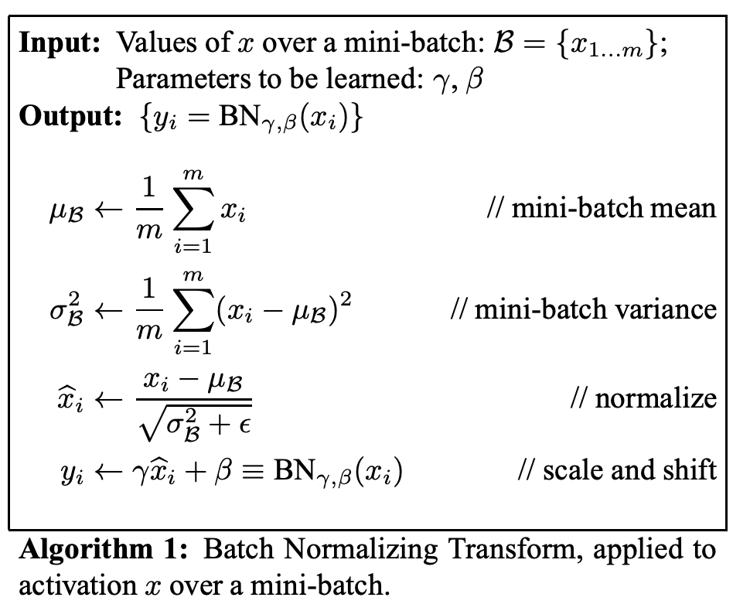
Batch Normalization (BN): What?
Batch norm with 2 trainable parameters
$β$ and $γ$ for mean and deviation
https://arxiv.org/pdf/1502.03167v3.pdf

Slide 28
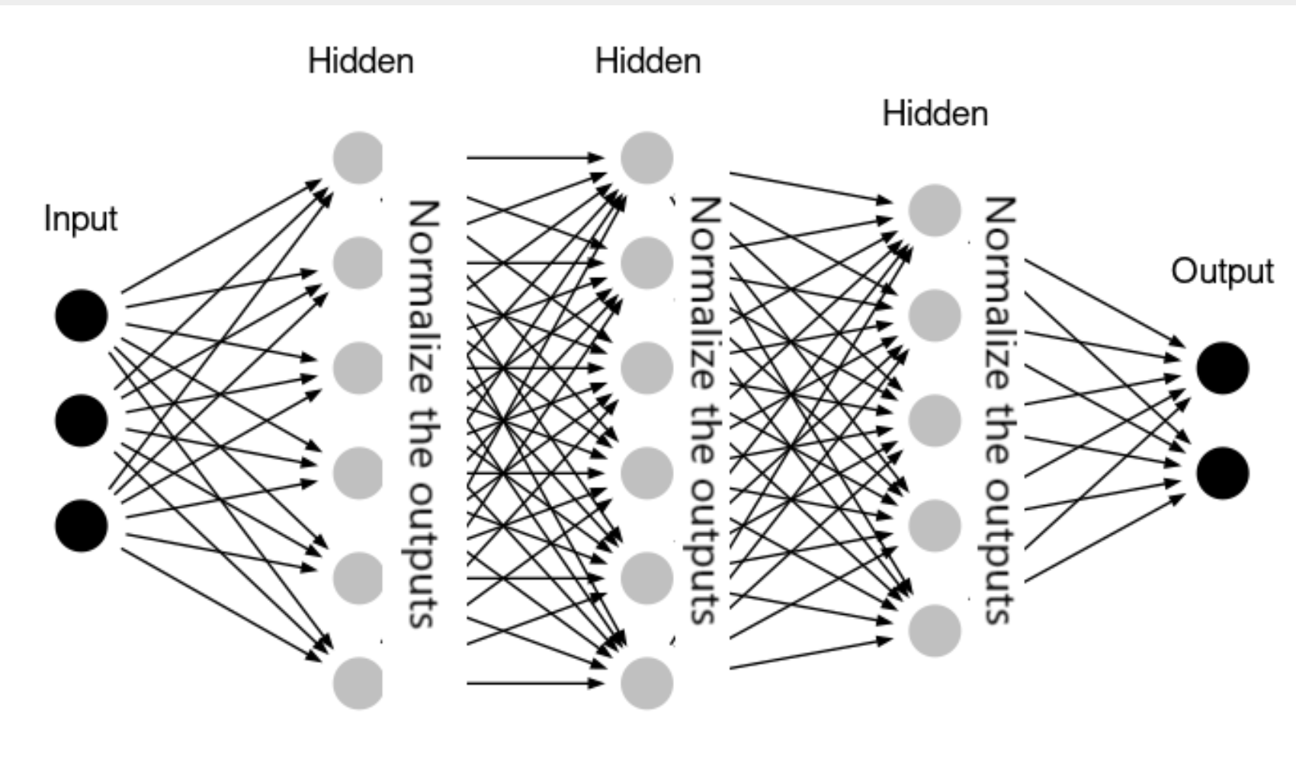
Batch Normalization (BN): Where?
https://analyticsindiamag.com/hands-on-guide-to-implement-batch-normalization-in-deep-learning-models/

Slide 29
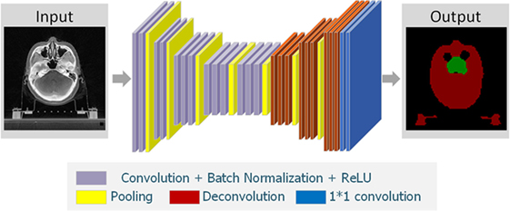
Batch Normalization: A Key Trick
https://www.frontiersin.org/articles/10.3389/fonc.2017.00315/full

Slide 30
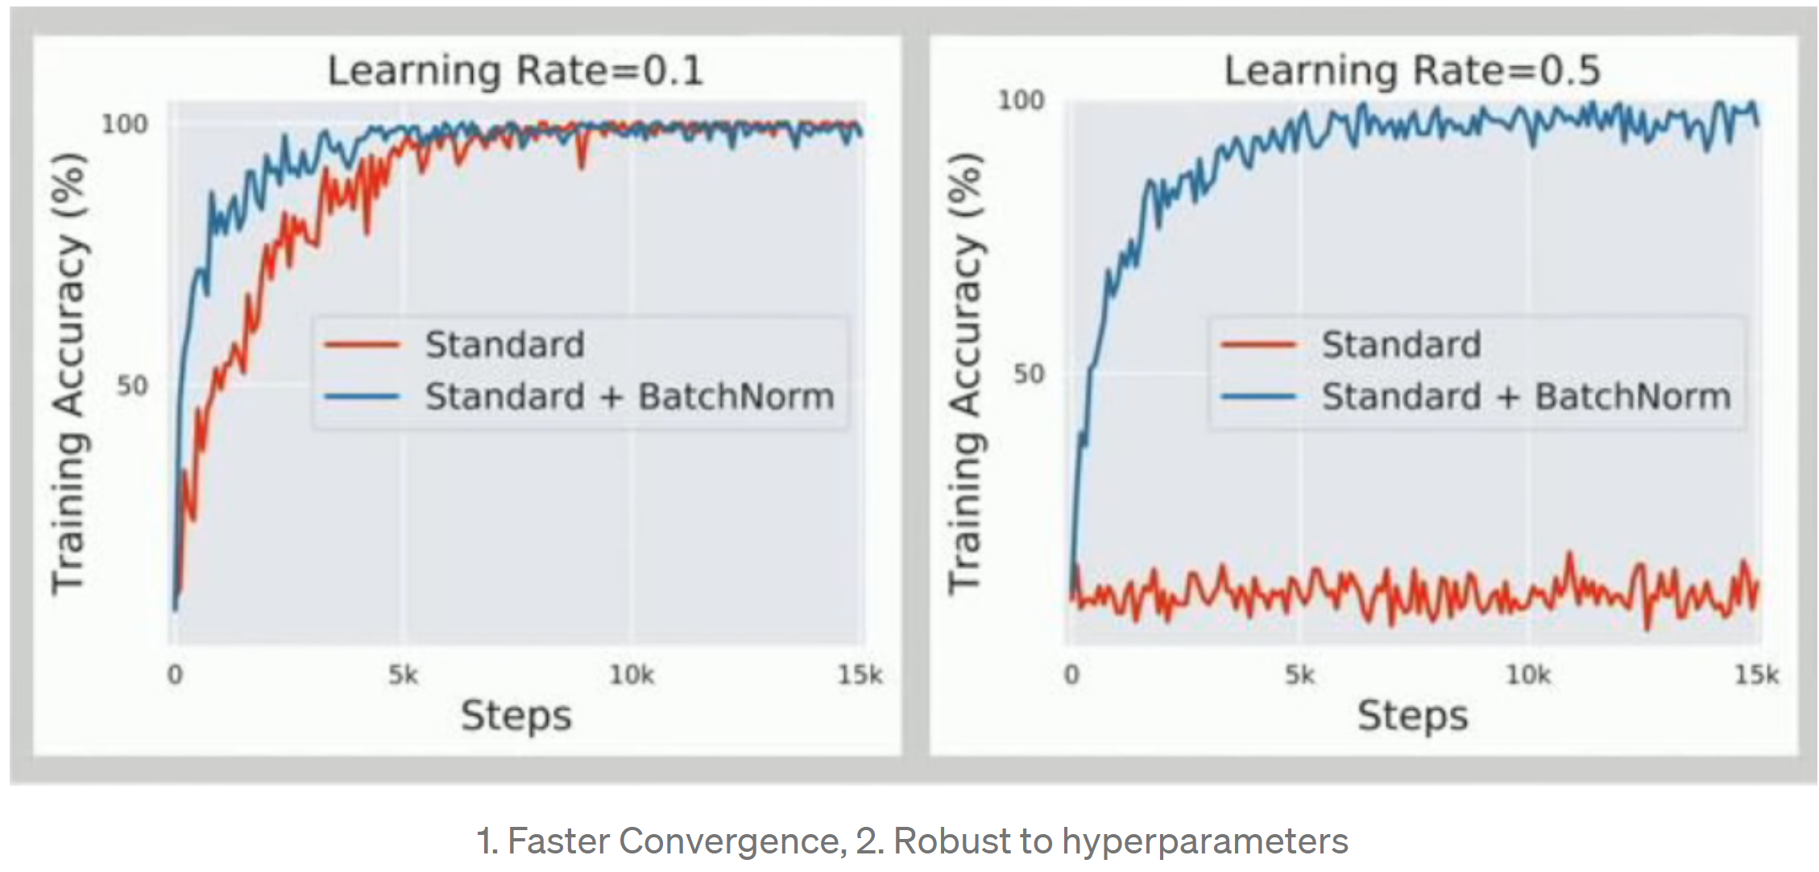
Batch Normalization (BN): Why?
https://towardsdatascience.com/curse-of-batch-normalization-8e6dd20bc304

Slide 31
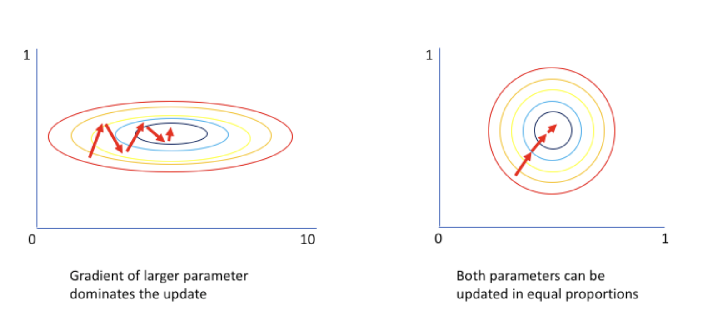
Batch Normalization (BN): Why?

Slide 32
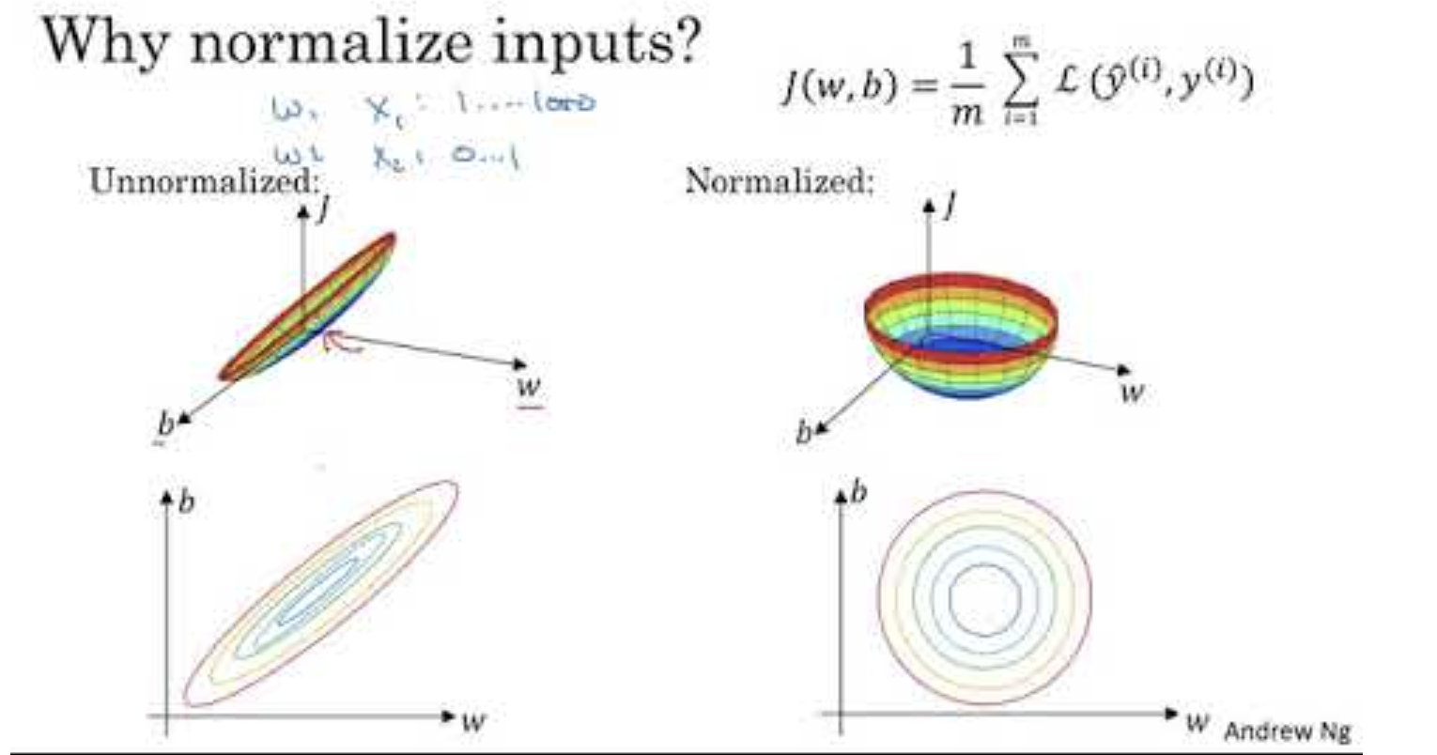

Slide 33
ResNet: Key Idea
Researchers found that when the number of layers increases, the testing accuracy degrades
If the added layers can be constructed as identity mappings, a deeper model should not produce higher errors than its shallower counterparts
Instead of letting the network learn the mapping, ResNet allows the gradient flow directly to later layers from earlier layers

Slide 34
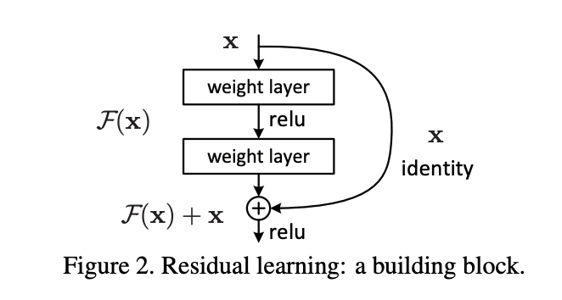
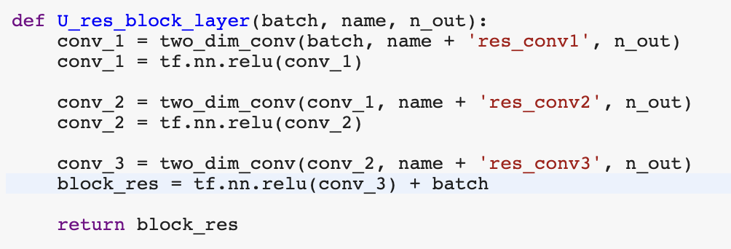
Resnet: Implementation
Autoencoder2.ipynb adds resnet block after each convolutional layers

Slide 35
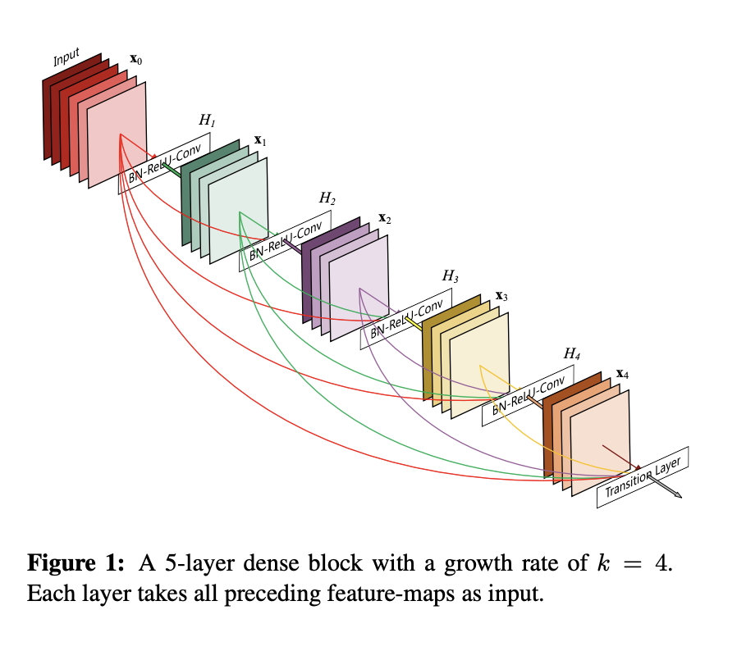
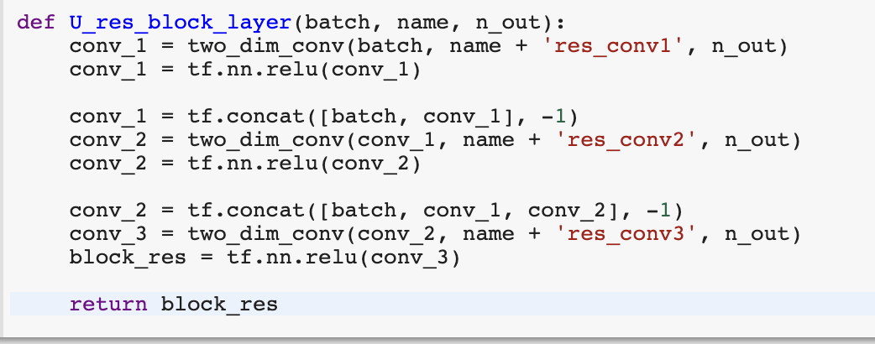
DenseNet: Example
Autoencoder3.ipynb adds DenseNet into
the network

Slide 36
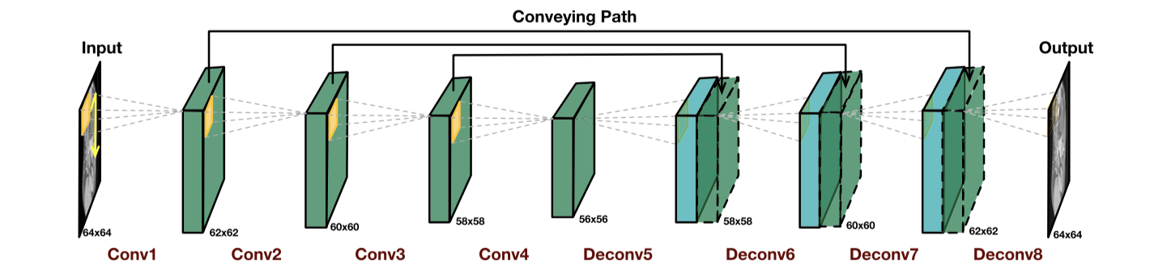
Generator Network
This is the same as the denoising network as hands-on 3.

Slide 37
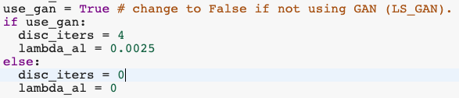
GAN is Optional
Please note the the LS-GAN is optional. Using GAN will significantly increase training time. You can simple change the “True” to “False” to de-activate GAN.
We usually train the discriminator much more than the generator.
In this case, I trained the discriminator 4 times and then the generator 1 time.
You can change “4” to “3” if you like by setting the “disc_itres” variable.

Slide 38
Least Squares GAN (LS-GAN)
This is the simplest GAN to implement and understand.
Generator (G)
Input
Results
Ground Truth Image
Discriminator (D)
Real? Fake?

Slide 39
Homework
Experiment with Autoencoder2.ipynb and Autoencoder3.ipynb to use the Resnet and Dense blocks discussed before.
Please run all the codes and report the results.

