Slide 1

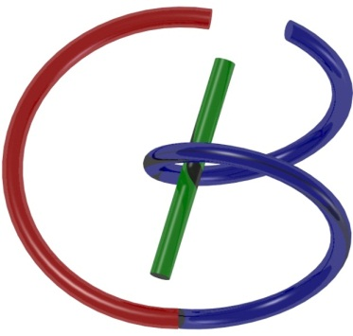
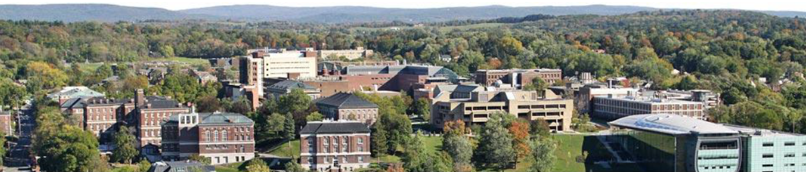
Matlab Tutorial #2
Kathleen Chen
chens18@rpi.edu
February 13, 2018

Slide 2

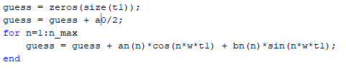
BB05 Fourier Series
Determination of Fourier components from the code given in the video
Use these Fourier components to create a curve close to the square wave

Slide 3
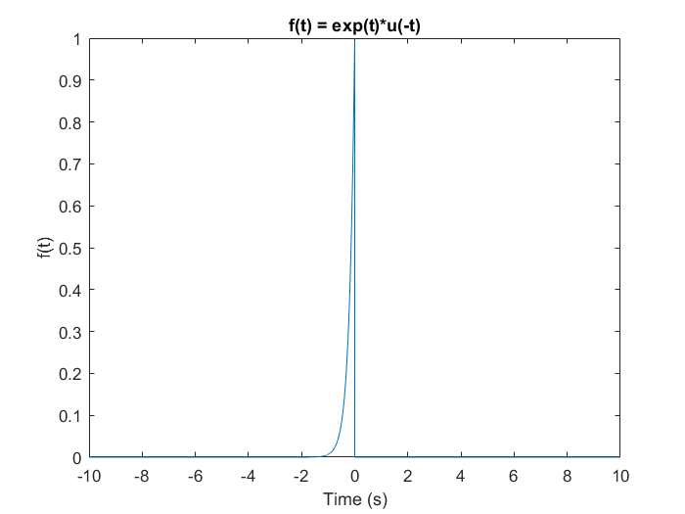
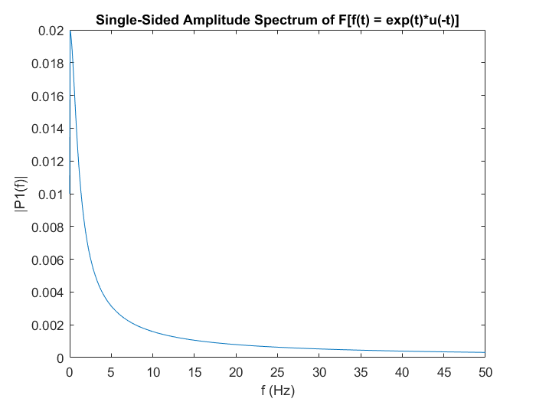
BB06 Fourier Transform Part 2
Two answers were accepted:
  Analytical – http://www.youtube.com/watch?v=1hX_MUh8wfk
  MATLAB –

Slide 4
Outline
Discrete Convolution
  Zero-padding
  Circular Equivalent to Linear
Spectral Analysis
  Zero-padding
  Refined Spectral Bins
2D Filtering
  Noise Removal
  Edge Enhancement

Slide 5
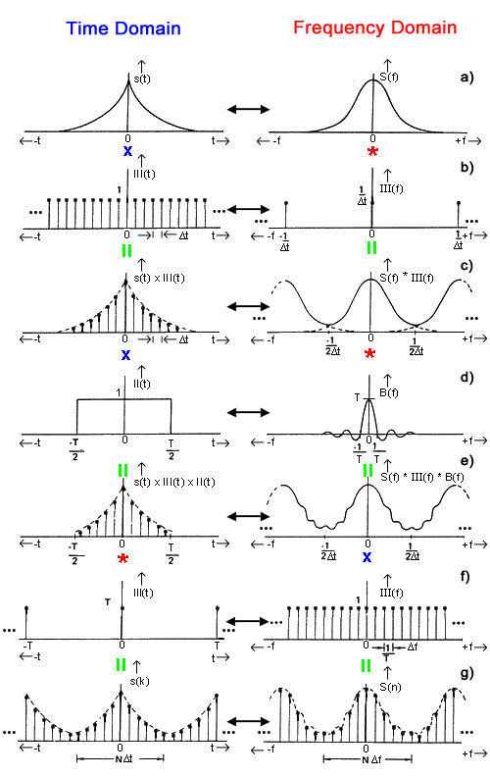

Visualization of Discrete FT

Slide 6


Hands-on Example

Slide 7
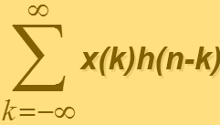
Multiplications at n=0
f(k)
0
1
2
3
4
g(-k)
-4
-3
-2
-1
0
1
2
3
4

Slide 8
Multiplications at n=8
f(k)
0
1
2
3
4
g(8-k)
-4
-3
-2
-1
0
1
2
3
4

Slide 9
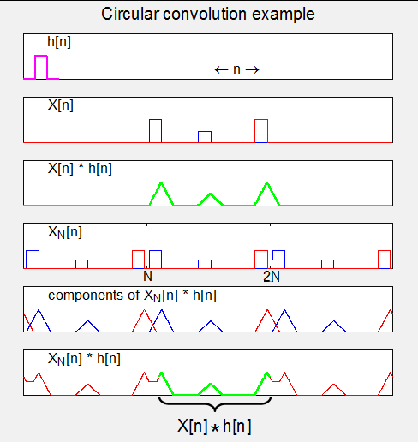
Functional example
h(n)
X(n)
Linear convolution result of X(n) and h(n)
XN(n) where X is now periodic with N components (“circularly extended”)
Components of linear convolution of XN(n), h(n)
  Edge effects
Composite output (green section is unaffected by edge effects (“desired” solution)
*We would need zero padding here!*

Slide 10
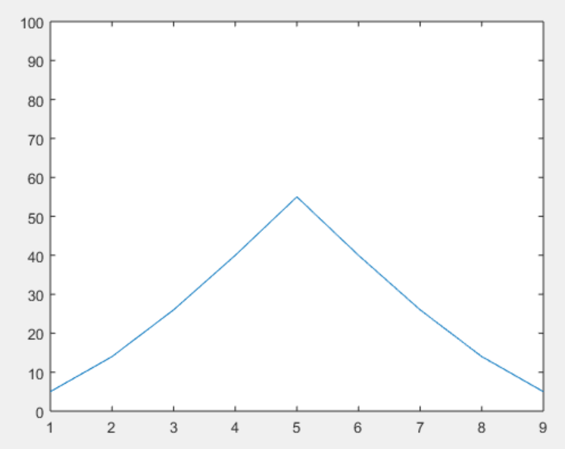
Hands-on Result
>>
x=[5 4 3 2 1];
h=[1 2 3 4 5];
y=conv(x,h);
plot(y); ylim([0 100]);
>>

Slide 11


Circular Convolution

Slide 12
Convolution with Zero Padding

Slide 13
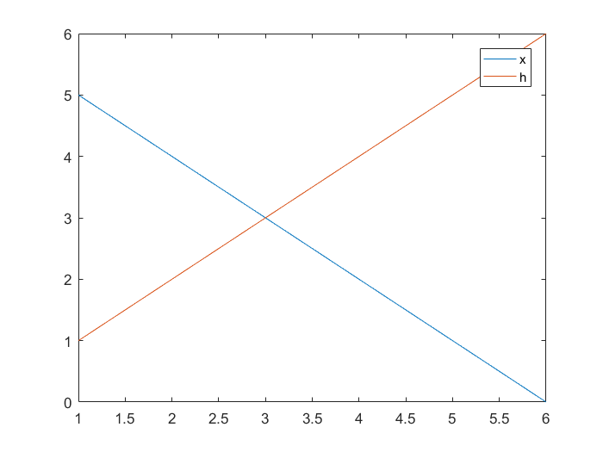
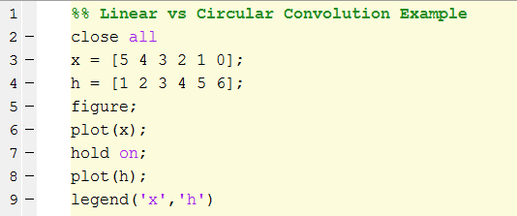
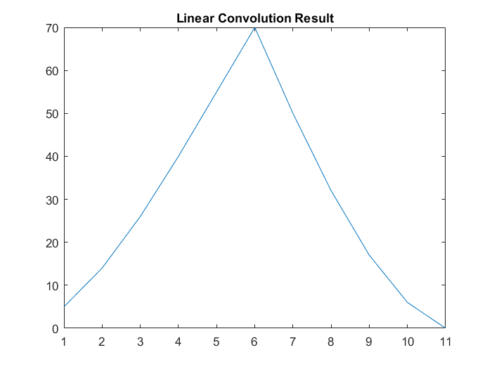
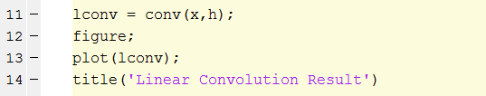

Slide 14
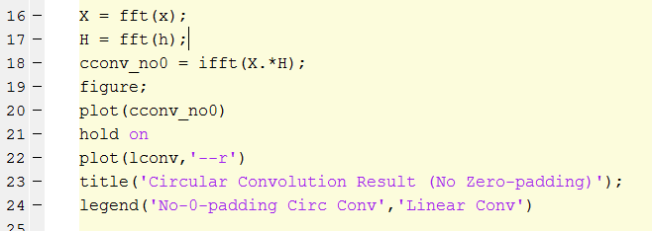
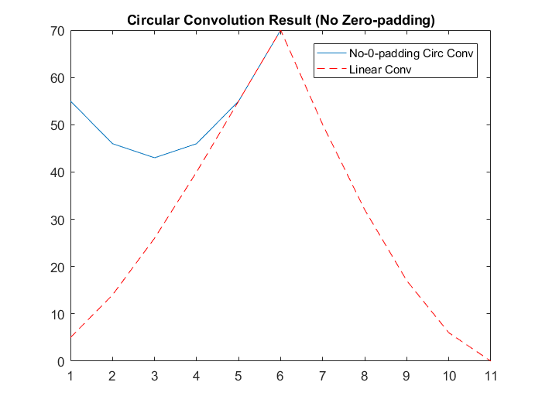
Circular convolution w/o zero padding ≠ Linear convolution!

Slide 15
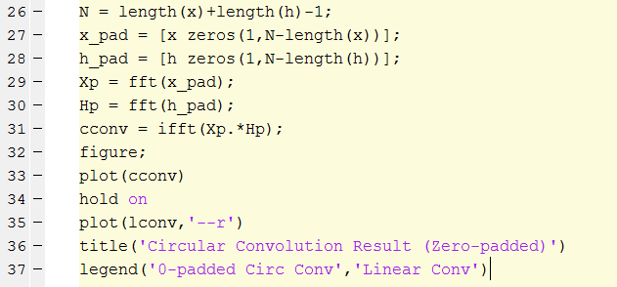
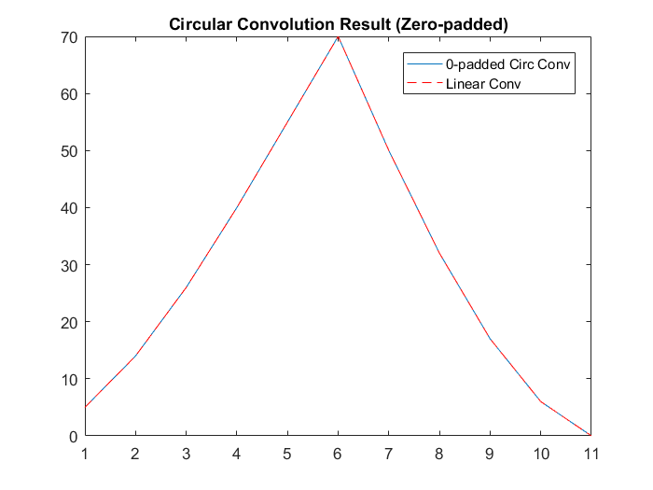

Slide 16
Outline
Discrete Convolution
  Zero-padding
  Circular Equivalent to Linear
Spectral Analysis
  Zero-padding
  Refined Spectral Bins
2D Filtering
  Noise Removal
  Edge Enhancement

Slide 17

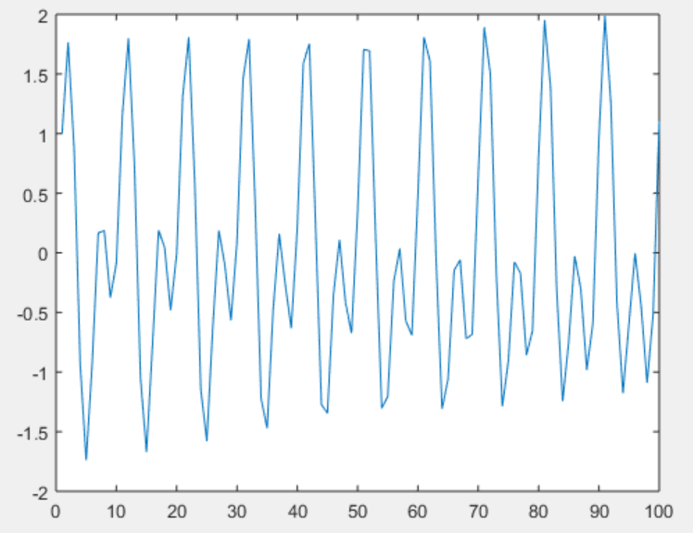
Synthetic Waveform
Fs = 1e3;
t = 0:0.001:1‐0.001;
x = cos(2*pi*100*t)+sin(2*pi*202.5*t);
Plot(x(1:100));
https://www.mathworks.com/help/signal/ug/amplitude-estimation-and-zero-padding.html

Slide 18
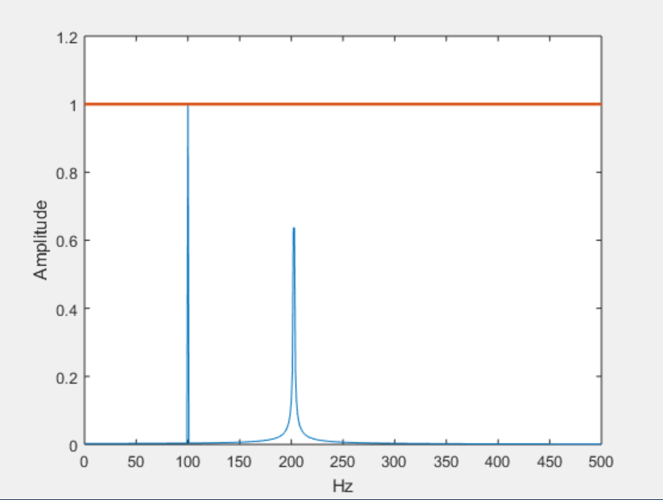
Without Zero Padding
xdft = fft(x);
xdft = xdft(1:length(x)/2+1);
xdft = xdft/length(x);
xdft(2:500) = 2*xdft(2:500);
freq = 0:Fs/length(x):Fs/2;
plot(freq,abs(xdft))
hold on
plot(freq,ones(length(x)/2+1,1),'LineWidth',2)
xlabel('Hz')
ylabel('Amplitude')
hold off
The 202.5 frequency is not well-resolved →Not within the default spectral bins (1 Hz)

Slide 19
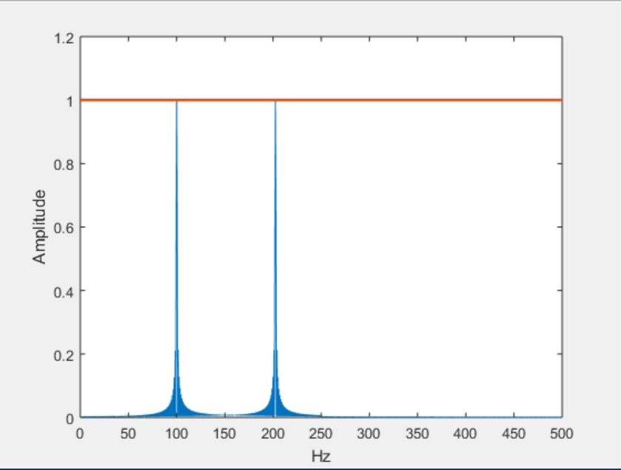
With Zero Padding
xdft = fft(x,2000);
xdft = xdft(1:length(xdft)/2+1);
xdft = xdft/length(x);
xdft(2:500) = 2*xdft(2:500);
freq =0:Fs/(2*length(x)):Fs/2;
plot(freq,abs(xdft))
hold on
plot(freq,ones(2*length(x)/2+1,1),'LineWidth',2)
xlabel('Hz')
ylabel('Amplitude')
hold off
Both frequencies are well-resolved →Within the default spectral bins (spacing between DFT bins is Fs/2000 = 0.5Hz)

Slide 20
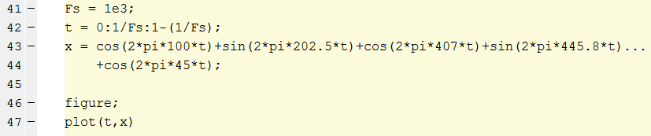
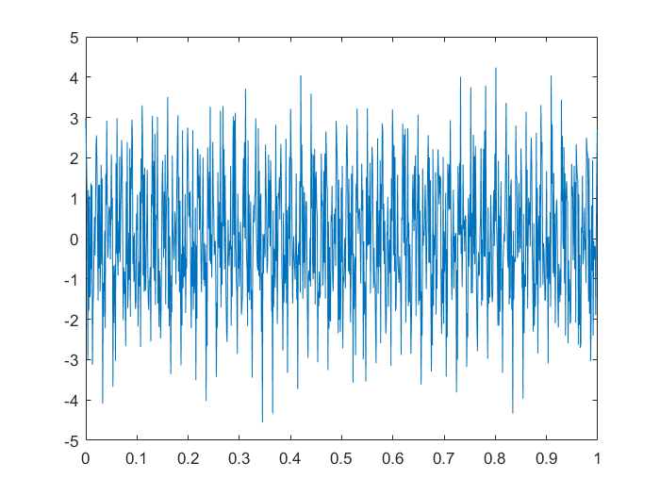
Continuous Function

Slide 21
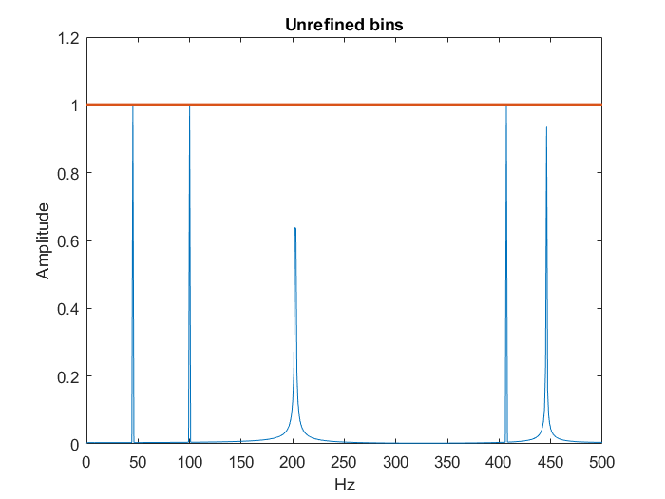
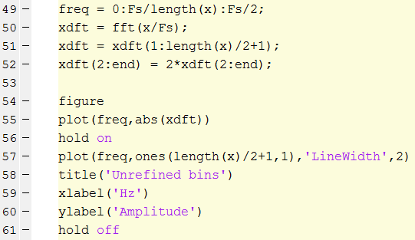
The 202.5, 445.8 frequencies are not well-resolved; Frequencies are not discrete

Slide 22
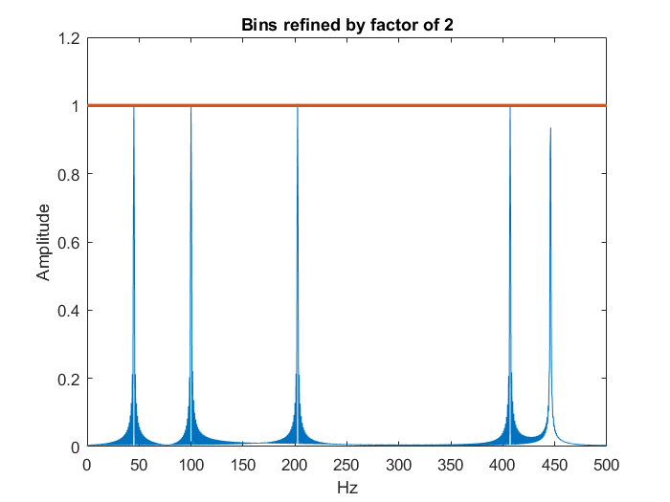
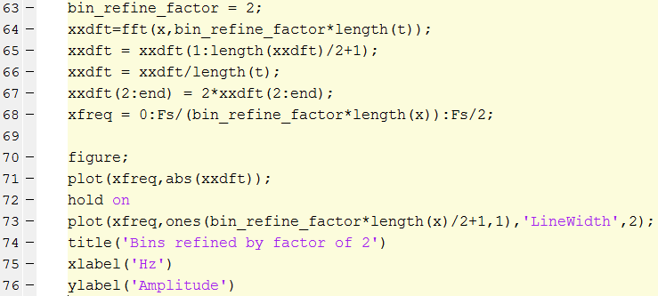
The 445.8 frequencies is not well-resolved; Frequencies are not discrete

Slide 23
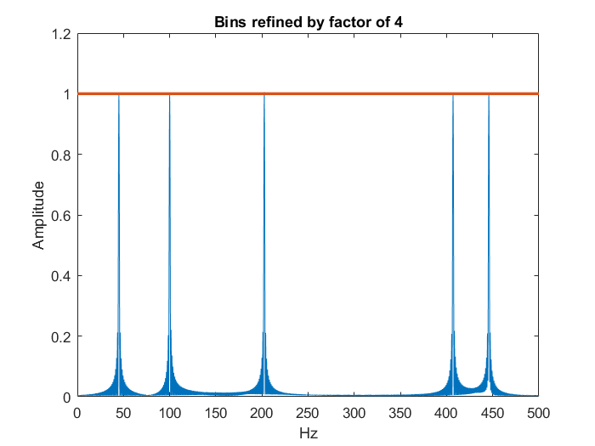
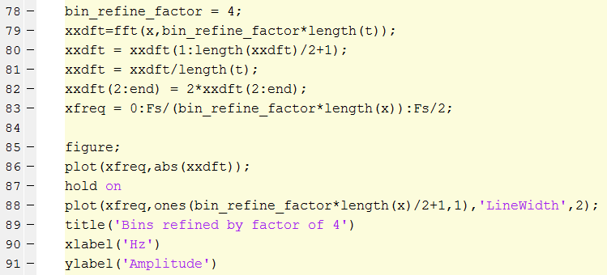
All frequencies are well-resolved!

Slide 24
Outline
Discrete Convolution
  Zero-padding
  Circular Equivalent to Linear
Spectral Analysis
  Zero-padding
  Refined Spectral Bins
2D Filtering
  Noise Removal
  Edge Enhancement

Slide 25
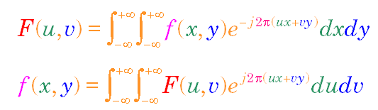
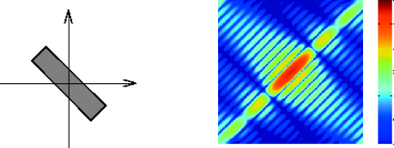
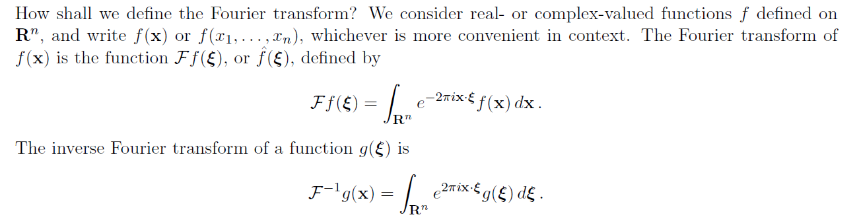
2D Fourier Transform

Slide 26
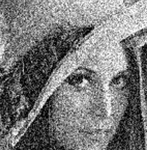
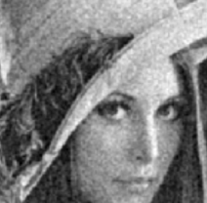
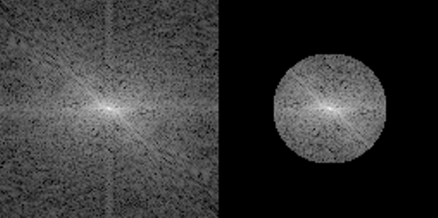
Noise Suppression
FT
IFT

Slide 27
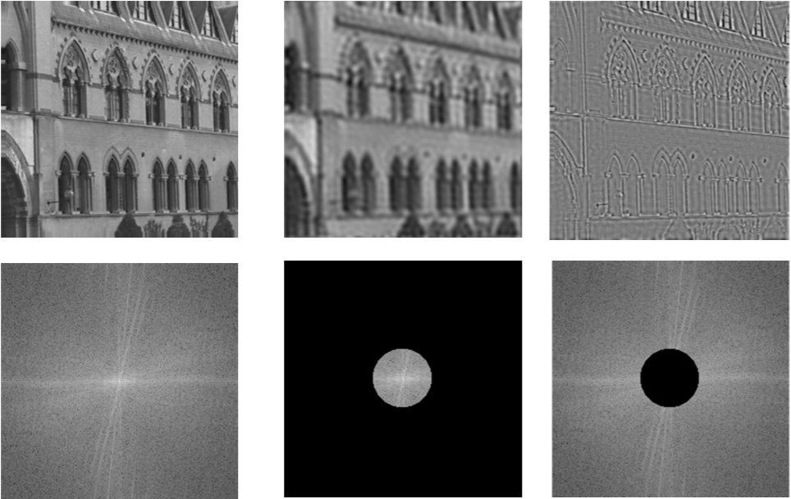
Low-/High-pass Filtering

Slide 28
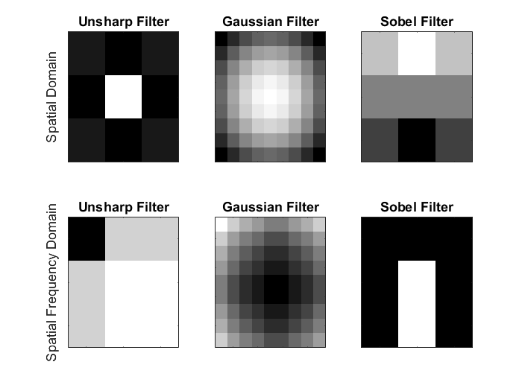
2D Image Filters

Slide 29
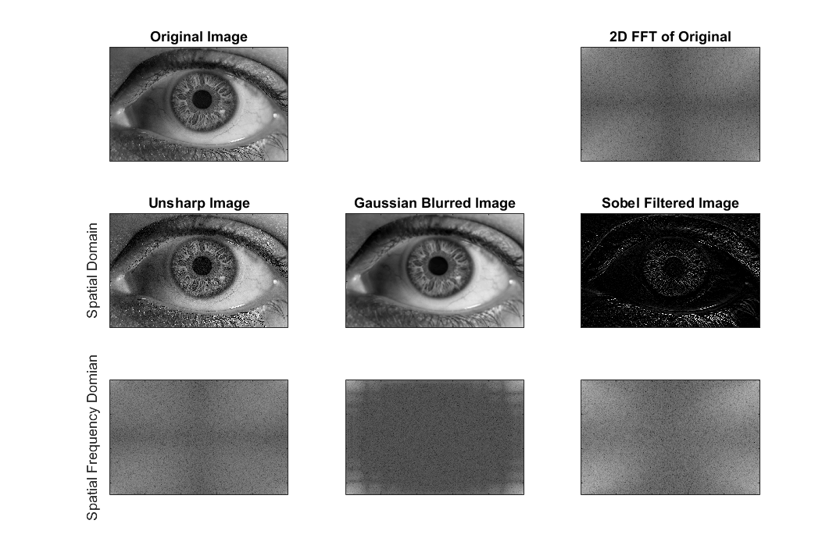
Filtered Images

Slide 30
ArtX Homework: Overview Poster
DFT & FFT
Signal Processing
Fourier Series
Fourier Transform
Periodic
Non-periodic
Convolution
Shift-invariant Linear System
Function/System
Due Fri

